Slide 1
Samsung
Innovation
Campus
Coding and Programming

Slide 2
Chapter 4.
Algorithm 1 - Data Structures
Coding and Programming

Slide 3
Chapter Description
Chapter objectives
Learners will be able to understand the concept of data structures, define and apply abstract data types including stack, queue, and hash table. Also, learners will be able to understand linear search and binary search to solve search problems, while be able to compare data search methods using hash table and algorithm performance.
Chapter contents
Unit 22. Stack
Unit 23. Queue
Unit 24. Sequential Search
Unit 25. Binary Search
Unit 26. Hash Table

Slide 4
Unit 22.
Stack

Slide 5
Unit learning objective (1/3)
UNIT 22
Learning objectives
Understand the concept of stack and be able to define stack as abstract data type.
Be able to implement stack data structures into classes in Python language.
Be able to make applications of stack data structures to solve balanced parentheses problems.

Slide 6
Unit learning objective (2/3)
UNIT 22
Learning overview
Learn the methods to implement stack data structures using Python lists.
Learn the methods to define stack data structures as Python’s class.
Learn the methods to solve balanced parentheses problems by using stack data structures.
Concepts You Will Need to Know From Previous Units
Declaring a list, add and delete items.
Define class constructor and define variables and methods.
Creating class instance to approach to the variables and call methods.

Slide 7
Unit learning objective (3/3)
UNIT 22
Keywords
Abstract
Data Type
Stack
LIFO
push
pop

Slide 8
Unit 22.
Stack
Mission

Slide 9
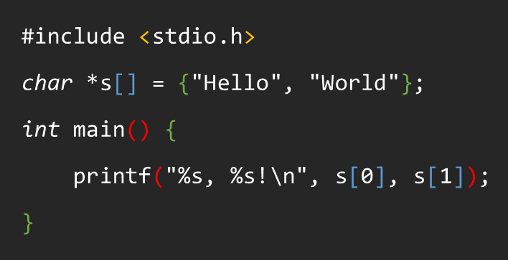
Mission
UNIT 22
1. Real world problem
1.1. Parentheses in source codes
There are different kinds of parentheses in computer program source codes, and they need to be paired.
The figure on the left shows the source code of “Hello, Word!” program written in C language. The figure below provides a sequential listing of the parentheses included in this source code (square brackets, braces, and round brackets).
[]{}(){([][])}
If the parentheses above are invalid due to inappropriate pairing, the C language compiler will print an error. Parentheses in Python language should be appropriately paired.
How should we check if the parentheses are appropriately paired in the given source code?

Slide 10
Mission
UNIT 22
2. Mission
2.1. Balanced parentheses checker
Make a program to check if the balanced parentheses are valid or invalid when strings consist of square backet, brace, and round bracket are provided as below.
[]{}()
(((
((()))
(((]]]
({[]})
)(][}{
Valid
Invalid

Slide 11
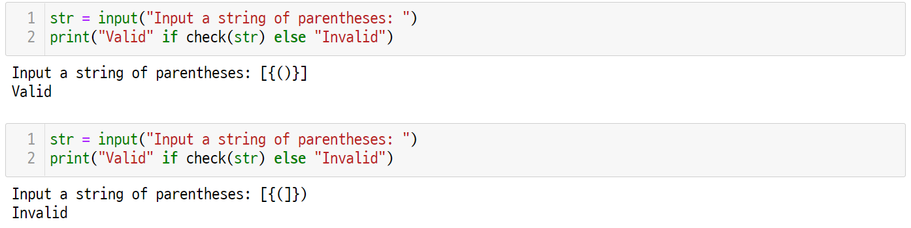
Mission
UNIT 22
3. Solution
3.1. How the balanced parentheses checker works
The balanced parentheses inputs are then classified into either valid or invalid.

Slide 12
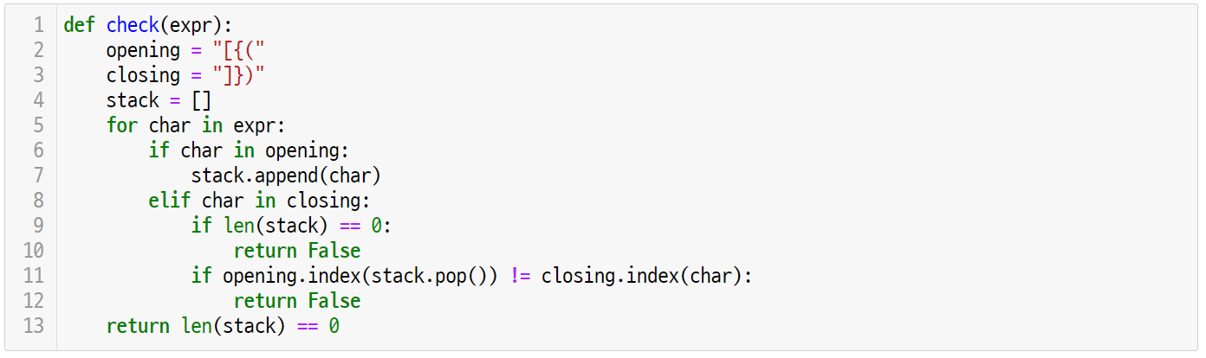
Mission
UNIT 22
3. Solution
3.2. Balanced parentheses checker final code

Slide 13
Unit 22.
Stack
Key concept

Slide 14


Key concept
UNIT 22
1. Algorithms and Data Structures
1.1. Pre-defined data types and user-defined data types
All of the programming languages provide defined data types. In Python, there are many different kinds of built-in data types including integer type, real type, logic type, string, list, dictionary, etc.
Also, all of the programming languages provide a way to define a new data type.
In Python, users can define a new data type as a class.
FOCUS
Abstract data type refers to the data type defined by the user.

Slide 15
Key concept
UNIT 22
1. Algorithms and Data Structures
1.2. Algorithms and data structures
Algorithm refers to a step-by-step procedure to solve a given problem in an effective manner. Data structure is an abstract concept that forms and organizes data for effective insertion and extraction.
Thus, an efficient algorithm must be used to define a data structure, and an appropriate data structure should be selected to design an efficient algorithm.
FOCUS
Computer program is a set of data structure and algorithm.

Slide 16
Key concept
UNIT 22
2. What is a Stack?
2.1. Definition of a stack
Stack is an abstract data type in which an item can be added or deleted only at one side of the top. This data type works by the LIFO (Last-In-First-Out) method where you can remove the item first that was previously entered very last.
Focus
Stack must provide the following two interfaces.
push: Adds a new item on the top.
pop: Removes an item from the top.
X
X
push
pop
X
top
X
C
top
C
C
top
B
B
B
A
bottom
A
A
stack
stack
stack

Slide 17

Key concept
UNIT 22
2. What is a Stack?
2.2. Examples of a stack
Stack is commonly found in real life situations.
For instance, dishes are stacked while dishwashing and are then taken by one by one for washing.
Other examples of a stack in real life include stacking books, coins, and shuttlecock container and Pringles.
What would be other examples of a stack?

Slide 18


Key concept
UNIT 22
2. What is a Stack?
2.2. Examples of a stack
The web browser accumulates the recently visited website addresses in a stack. When visiting a new page, it will be accumulated on the top of the stack.
If the user clicks ‘back,’ the address on the top of the stack is selected which will show previously visited website.
There’s an undo function in the text editor and MS Word.
This function also accumulates editing operations done by the user into a stack, and the ‘undo’ will cancel the operations in order from the top of the stack.

Slide 19
Key concept
UNIT 22
2. What is a Stack?
2.3. Applications of a stack
Take a parking lot in the figure below for an example.
On the left, there are 5 cars parked along the dead end, and the lane on the bottom is also a dead-end. The drivers of the cars arrived in the order of 2, 3, 1, 4, 5 with random time interval. The cars need to get out to the right in the order of 1, 2, 3, 4, 5.
If you’re a parking lot manager, how would you solve this problem?
2
3
1
4
5
5
4
3
2
1
exit
parking lot

Slide 20
Key concept
UNIT 22
2. What is a Stack?
2.3. Applications of a stack
Before trying to solve the parking lot problem, think of a railroad track that looks like below.
If a train that has plate numbers from 1 to 5 enters the track from the left and gets out to the right, then the plate number will be in a reversed order.
5 4 3 2 1
1 2 3 4 5

Slide 21
Key concept
UNIT 22
2. What is a Stack?
2.3. Applications of a stack
Solve the parking lot problem as follows.
First, temporarily park the car no.5 in the bottom alley.
2
3
1
4
5
5

Slide 22
Key concept
UNIT 22
2. What is a Stack?
2.3. Applications of a stack
Next, also park the car no.4 in the bottom alley.
2
3
1
4
4
5

Slide 23
Key concept
UNIT 22
2. What is a Stack?
2.3. Applications of a stack
Now, the car no.1 can get out of the parking lot first.
2
3
1
1
4
5

Slide 24
Key concept
UNIT 22
2. What is a Stack?
2.3. Applications of a stack
Again, temporarily park the car no.3 in the bottom alley.
2
3
1
3
4
5

Slide 25
Key concept
UNIT 22
2. What is a Stack?
2.3. Applications of a stack
Then, the car no.2 can get out of the parking lot followed by car no.1.
2
2
1
3
4
5

Slide 26
Key concept
UNIT 22
2. What is a Stack?
2.3. Applications of a stack
Because the bottom alley is parked with right order of cars that need to get out, the car no.3 can get out followed by car no.2.
It is important to understand that the car no.3 is the last car parked in the bottom alley.
3
2
1
3
4
5

Slide 27
Key concept
UNIT 22
2. What is a Stack?
2.3. Applications of a stack
This time, the last car parked in the bottom alley is car no.4.
The car no.4 can get out of the parking lot followed by car no.3.
4
3
2
1
4
5

Slide 28
Key concept
UNIT 22
2. What is a Stack?
2.3. Applications of a stack
Now, if the car no.5 gets out of the parking lot, then the problem is solved.
The car no.5 that gets out of the parking lot very last is the car that was first parked in the bottom alley.
5
4
3
2
1
5

Slide 29
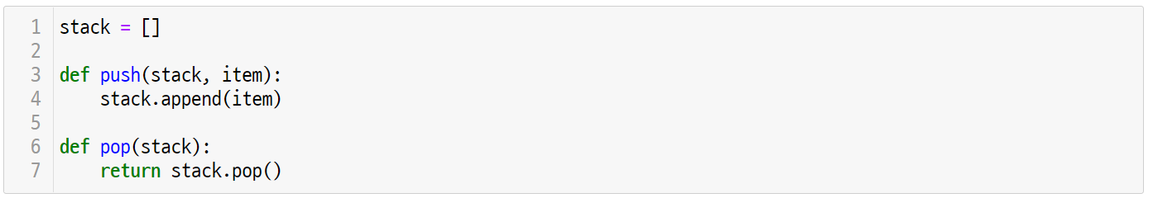
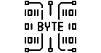
Key concept
UNIT 22
3. Implement a Stack
3.1. Using a list data type
In Python, a stack can be defined as follows by using the list data type.
Line 1
Define a stack as a list type variable.
Addition or deletion of an element is possible at any location in the phyton list type, so an additional interface must be provided to perform ‘push’ and ‘pop’ for stack implementation.

Slide 30
Key concept
UNIT 22
3. Implement a Stack
3.1. Using a list data type
For convenience, assume that the last element of the stack is ‘top.’ Then, the ‘push’ will add the element at the top of the stack.
Line 3-4
The ‘push’ function receives input of the list type stack and item to be added.
Since the ‘push’ will add the item to the top of the stack, use the append() function of the stack list.

Slide 31
Key concept
UNIT 22
3. Implement a Stack
3.1. Using a list data type
The ‘pop’ will delete the last element of the stack and return the deleted element.
Line 6-7
The list type stack is input of the ‘pop’ function.
Since ‘pop’ deletes and returns the top element of the stack, use pop() function of the stack list.

Slide 32
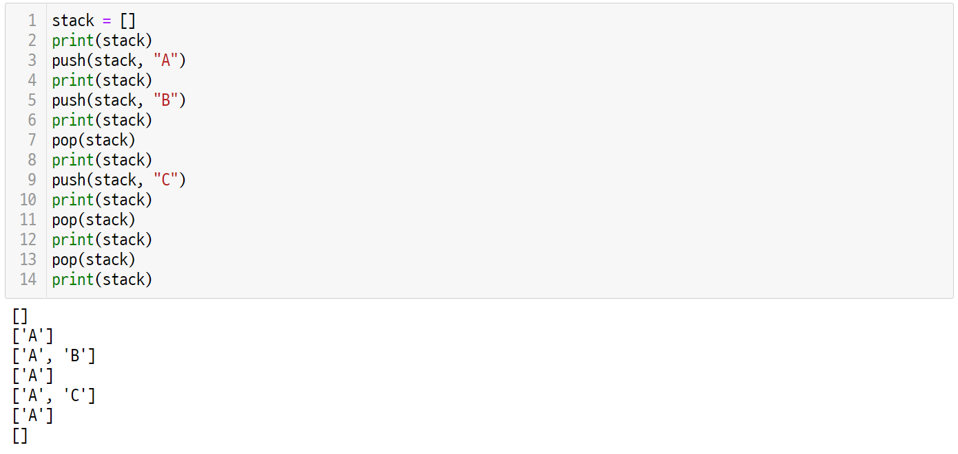
Key concept
UNIT 22
3. Implement a Stack
3.1. Using a list data type
The following code tests the stack data structure that was defined previously.
Notes:
교사는 위의 코드 순서를 임의로 변경하면서 스택의 내용이 어떻게 변하는 지를 학생들에게 그림으로 설명한다.

Slide 33

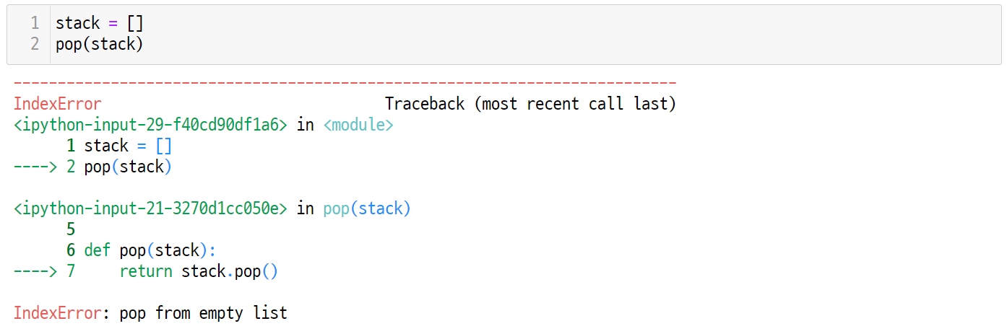
Key concept
UNIT 22
3. Implement a Stack
3.1. Using a list data type
When the ‘pop’ is asked in an empty stack, IndexError occurs because the stack has nothing to delete.
IndexError

Slide 34
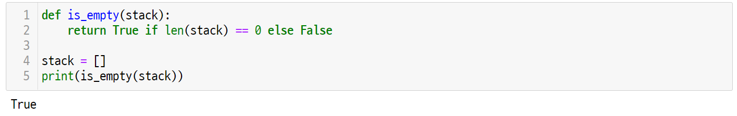
Key concept
UNIT 22
3. Implement a Stack
3.1. Using a list data type
To solve the IndexError problem in an empty stack, first create the function ‘is_empty()’ to check if the stack is empty.
Line 1-2
The is_empty() function returns False if the length of the stack as a parameter is 0, and True if not.
When initializing a stack, the stack length is 0. So, is_empty() returns True.

Slide 35
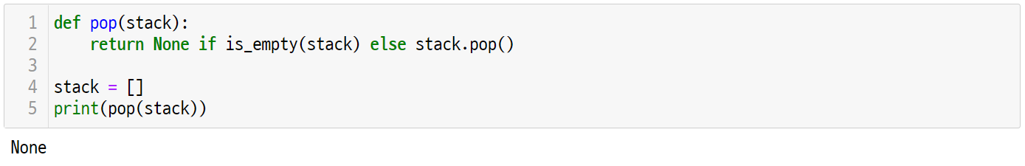
Key concept
UNIT 22
3. Implement a Stack
3.1. Using a list data type
To solve the IndexError problem in an empty stack, first create the function ‘is_empty()’ to check if the stack is empty.
Line 1-2
The pop() function deletes and returns the None object if the stack is empty, and if the stack is not empty, it deletes and returns the top element of the stack list.
The initialized stack is empty, so pop() returns None object and no IndexError occurs.

Slide 36
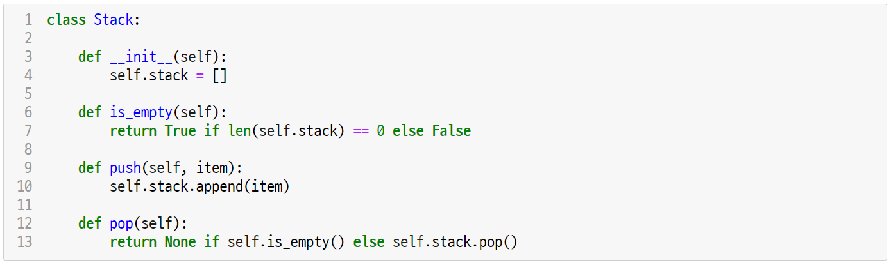
Key concept
UNIT 22
3. Implement a Stack
3.2. Define a stack as a class type
In Python, abstract data type can be defined as a class.
The abstract stack data type that was implemented as a list can be defined as a class as shown below.
Line 1-4
Define the stack data structure as a stack class.
__init__(self) constructor initializes the stack member field into an empty list.

Slide 37
Key concept
UNIT 22
3. Implement a Stack
3.2. Define a stack as a class type
The ’push’ can be implemented as the method of the stack class as shown below.
Line 9-10
The push() method receives the ‘self’ and ‘item’ to be added to the stack as parameters.
The ‘push’ adds the item to the top of the self.stack list which is the stack class member field.

Slide 38
Key concept
UNIT 22
3. Implement a Stack
3.2. Define a stack as a class type
The ’pop’ can be implemented as the method of the stack class as shown below.
Line 12-13
The pop() method receives ‘self’ as a parameter.
The ‘pop’ returns None if the self.is_empty() is True, and if not, it deletes and returns the top element of the self.stack.

Slide 39
Key concept
UNIT 22
3. Implement a Stack
3.2. Define a stack as a class type
The is_empty() method that checks if a stack is empty should also be defined as a stack class method.
Line 6-7
The is_empty() method returns True if the self.stack length is 0, and if not, it returns False.

Slide 40
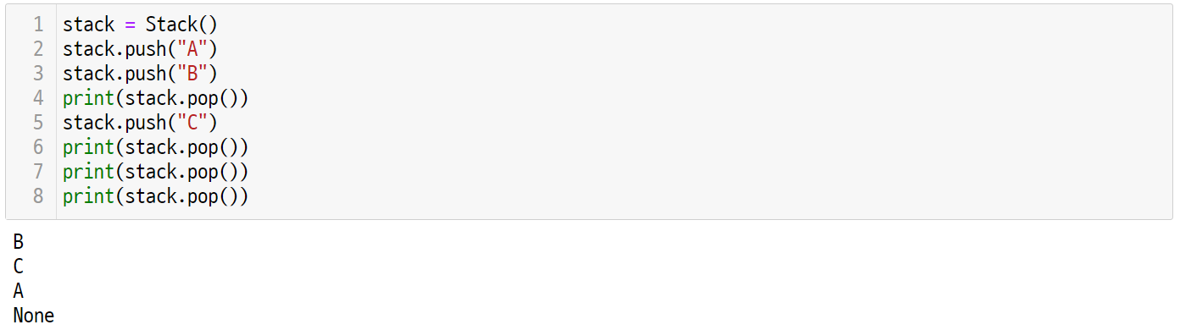
Key concept
UNIT 22
3. Implement a Stack
3.2. Define a stack as a class type
The following code tests the stack data structure that was defined as a class previously.
Line 1-8
The stack variable saves the object instance of a stack class that was created by calling Stack() constructor.
The push() and pop() methods of the stack object can be called by using a reference operator ‘.’
Print the returned value of the stack.pop() function into the print() function to identify the order of removal from the stack.
Notes:
교사는 위의 코드 순서를 임의로 변경하면서 스택의 내용이 어떻게 변하는 지를 학생들에게 그림으로 설명한다.

Slide 41


Key concept
UNIT 22
One More Step
The pop() function used the pop() method of the list to delete the top element of the stack and then returned it. How would you implement the peek() function that lets you know which element is on the top of the stack?
For the peek() method, simply return the top element without deleting the element.
It is also possible to define the peek() method as a member method of the stack class that was previously defined as follows.
TIP
When designating the index value as -1 in the Python list, it is possible to approach to the top element of the list.
stack[-1] == stack[len(stack) – 1]

Slide 42
Unit 22.
Stack
Let’s code

Slide 43

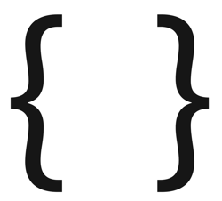

Let’s code
UNIT 22
1. Balanced Parentheses Problem
1.1. Problem definition
Write an algorithm that checks if the parentheses are valid when a string consists of parenthesis is given.
Print Valid if the string parentheses are valid, and if not, print Invalid.
Assume that there are three different kinds of parentheses that can be included in the input string.
Square bracket: [], Brace: {}, Round bracket: ()
Parentheses are valid only if satisfying the following conditions.
1. The right parentheses type should be paired up.
2. The parentheses should have a right order.
3. Consider the string without parentheses as valid parentheses.

Slide 44
Let’s code
UNIT 22
1. Balanced Parentheses Problem
1.2. Input & output examples
The following shows examples of the string containing valid and invalid parentheses.
Valid | Invalid
[]{}()
(
((()))
(]
({[]})
)(
[]{}()({[]})((()))
([()})
([]{()[]{}}())[{}]
([]{()[]){}}()[{}]

Slide 45
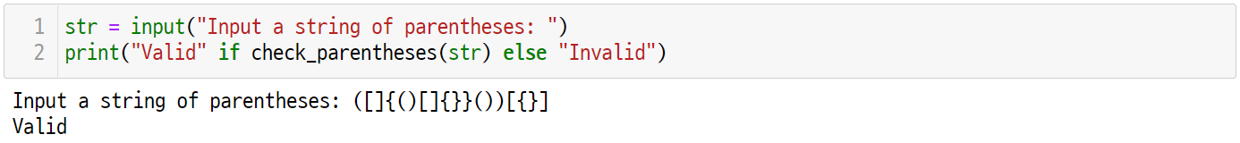
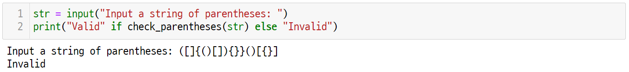
Let’s code
UNIT 22
1. Balanced Parentheses Problem
1.3. Codes for the solution
The check_parentheses() function receives the string consists of user-entered parentheses as input and prints valid if the parentheses are appropriately paired up and prints invalid if not.
Use this function to print valid or invalid as shown below.

Slide 46
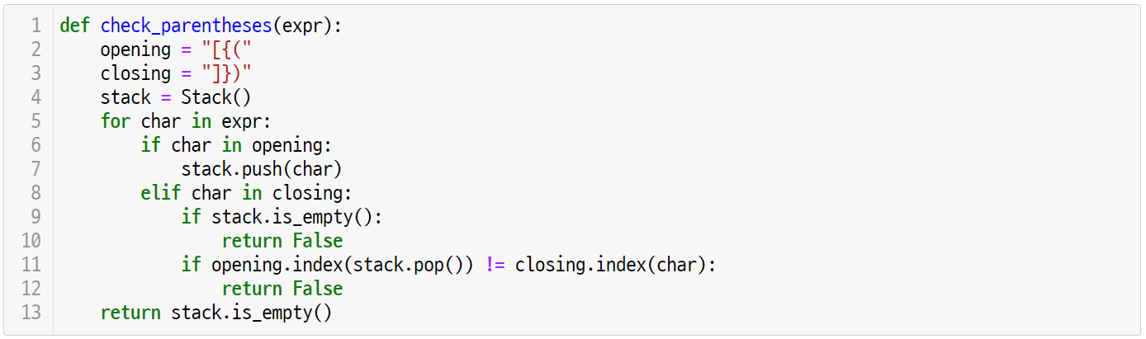
Let’s code
UNIT 22
1. Balanced Parentheses Problem
1.3. Codes for the solution
The following shows final results of the check_parentheses() function.

Slide 47
Let’s code
UNIT 22
1. Balanced Parentheses Problem
1.4. Solving the problem using a stack
Use a stack data structure to easily check if the parentheses are appropriately paired up. For instance, pair up the string provided below.
1
2
3
4
5
6
[
{
(
}
)
]
1. Push the open parenthesis into the stack.
2. Push the open parenthesis into the stack.
3. Push the open parenthesis into the stack.
1
2
3
[
{
(
push
push
push
(
{
{
[
[
[
stack
stack
stack

Slide 48
Let’s code
UNIT 22
1. Balanced Parentheses Problem
1.4. Solving the problem using a stack
1
2
3
4
5
6
[
{
(
}
}
]
4. When there is a close parenthesis, pop out the parenthesis from the stack for matching.
5. When there is a close parenthesis, pop out the parenthesis from the stack for matching.
4
5
)
(
}
{
pop
pop
matches
matches
(
{
{
[
[
stack
stack

Slide 49
Let’s code
UNIT 22
1. Balanced Parentheses Problem
1.4. Solving the problem using a stack
1
2
3
4
5
6
[
{
(
)
}
]
6. When there is a close parenthesis, pop out the parenthesis from the stack for matching.
7. If the stack is empty after checking all parentheses of the string, then you get balanced parentheses.
6
]
[
pop
matches
[
stack
stack

Slide 50
Let’s code
UNIT 22
1. Balanced Parentheses Problem
1.4. Solving the problem using a stack
The following shows unmatched parentheses.
1
2
3
4
5
6
[
{
(
}
]
)
Case 1. The close parenthesis does not match with the parenthesis popped out of the stack.
4
}
(
pop
does not
matches
(
{
[
stack

Slide 51
Let’s code
UNIT 22
1. Balanced Parentheses Problem
1.4. Solving the problem using a stack
The following shows unmatched parentheses.
1
2
3
4
5
6
7
[
{
(
}
)
]
)
Case 2. If there is a close parenthesis but the stack is empty.
7
}
pop
stack

Slide 52
Let’s code
UNIT 22
1. Balanced Parentheses Problem
1.4. Solving the problem using a stack
The following shows unmatched parentheses.
1
2
3
[
[
[
Case 3. If the stack is not empty even after checking all string.
[
[
[
stack

Slide 53
Let’s code
UNIT 22
1. Balanced Parentheses Problem
1.5. Implementation and coding
Define the function as follows to check balanced parentheses.
Line 1
The chek_parentheses() function receives the ‘expr’ string as input parameter.
This function returns True if there are matching parentheses in the expr string, and if not, it returns False.

Slide 54
Let’s code
UNIT 22
1. Balanced Parentheses Problem
1.5. Implementation and coding
Initialize the data structure required for algorithm implementation as follows.
Line 2-4
The ‘opening’ and ‘closing’ initializes open and close parentheses respectively. Notice that the matched parentheses are located in the same position of the string. The string index will check for matches.
The stack variable is initialized to the object instance of the stack class that was previously defined.

Slide 55
Let’s code
UNIT 22
1. Balanced Parentheses Problem
1.5. Implementation and coding
Implement a routine that processes open parentheses of each character in the given string.
Line 5-7
Check every character (char) in the expr string.
If the char is open parenthesis, push it to the stack.

Slide 56
Let’s code
UNIT 22
1. Balanced Parentheses Problem
1.5. Implementation and coding
Implement a routine to process close parentheses as follows.
Line 8-12
If the ’char’ is close parenthesis rather than an open parenthesis, check if it matches with another parenthesis.
The parentheses do not match if there’s a close parenthesis and empty stack. (Case 2)
The parentheses do not match if there’s a close parenthesis and the character position taken from the stack and string position of char are different. (Case 1)

Slide 57
Let’s code
UNIT 22
1. Balanced Parentheses Problem
1.5. Implementation and coding
After checking all of the string, return the results as follows.
Line 13
The parentheses do not match if the stack is not empty after checking all characters of the expr string. (Case 3)
If the stack is empty, there are matching parentheses so return the result of the empty stack.

Slide 58
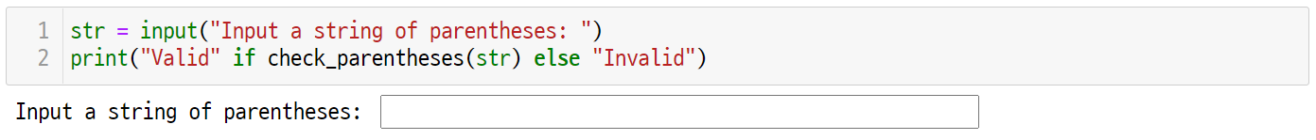
Let’s code
UNIT 22
1. Balanced Parentheses Problem
1.5. Implementation and coding
Examine various inputs of the check_parentheses() function through the following code.

Slide 59
Unit 22.
Stack
Pop quiz

Slide 60
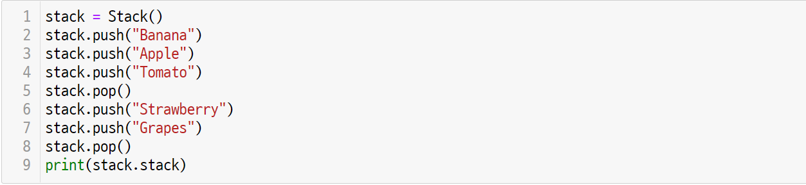
Pop quiz
UNIT 22
Quiz. #1
Write the output of the codes from the example that uses a stack.

Slide 61
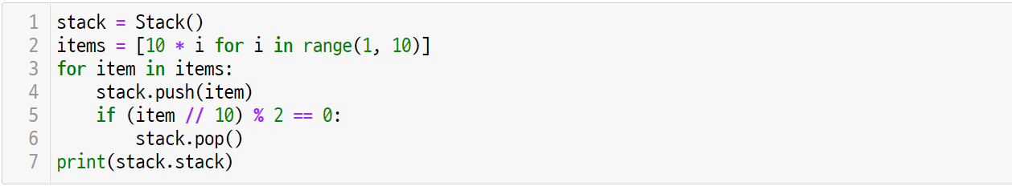
Pop quiz
UNIT 22
Quiz. #2
Write the output of the codes from the example that uses a stack.

Slide 62
Unit 22.
Stack
Pair programing

Slide 63
Pair programming
UNIT 22

Slide 64
Pair programming
UNIT 22

Slide 65
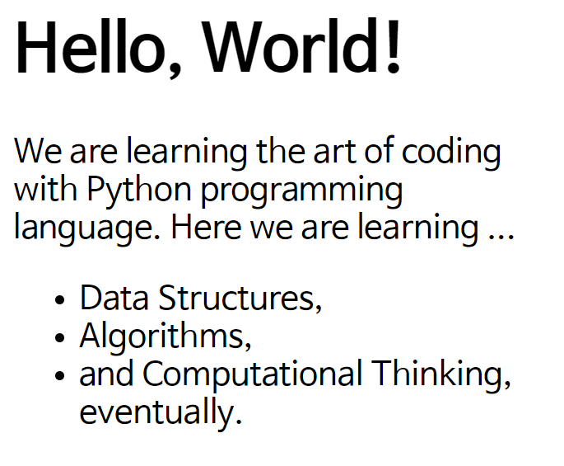
Pair programming
UNIT 22
Q1.
The HTML document consists of many tags as shown below. Write a program that matches HTML document tags.
Matching HTML Tags
<html>
<body>
<h1>Hello, World!</h1>
<p> We are learning the art of coding
with Python programming language.
Here we are learning ... </p>
<ul>
<li> Data Structures, </li>
<li> Algorithms, </li>
<li> and Computational Thinking,
eventually. </li>
</ul>
</body>
</html>

Slide 66
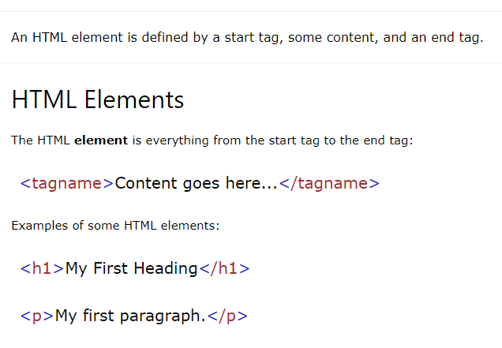
Pair programming
UNIT 22
Reference
https://www.w3schools.com/html/html_elements.asp

Slide 67
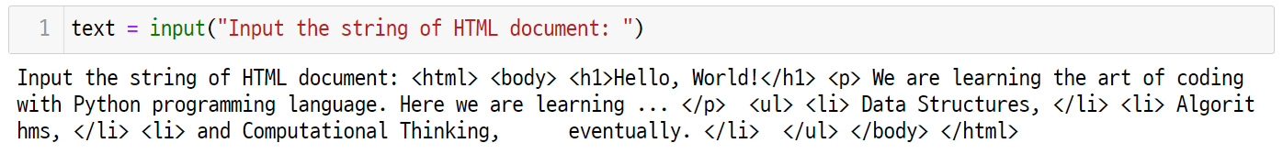
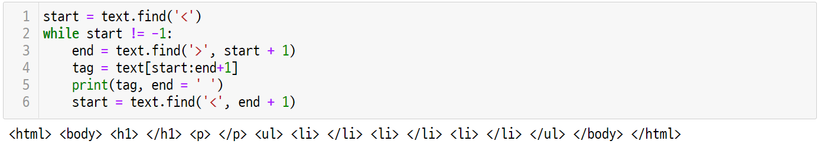
Pair programming
UNIT 22
TIP
In Python, the find() method is used to locate the start position of the substring. Find the ‘<‘ and ‘>’ to distinguish HTML document tags.
If the distinguished tag includes ‘/,’ then it is an open tag, and if not, it is a close tag. Check the HTML tag matching in a similar way of using a stack to match parentheses.

Slide 68
Unit 23.
Queue

Slide 69
Unit learning objective (1/3)
UNIT 23
Learning objectives
Understand the concept of a queue and be able to define a queue as abstract data type.
Be able to implement the queue data structure into a class by using python language.
Be able to apply the queue data structure to solve Josephus problem.

Slide 70
Unit learning objective (2/3)
UNIT 23
Learning overview
Learn how to define the queue data structure as a class
Learn how to use the queue class with its methods
Learn how to solve the Josephus problem by using the queue data structure
Concepts You Will Need to Know From Previous Units
How to declare a list, add and delete items
How to define class constructor and define variables and methods
How to create class instance to approach to the variables and call methods

Slide 71
Unit learning objective (3/3)
UNIT 23
Keywords
Abstract
Data Type
Queue
FIFO
enqueue
dequeue

Slide 72
Unit 23.
Queue
Mission

Slide 73
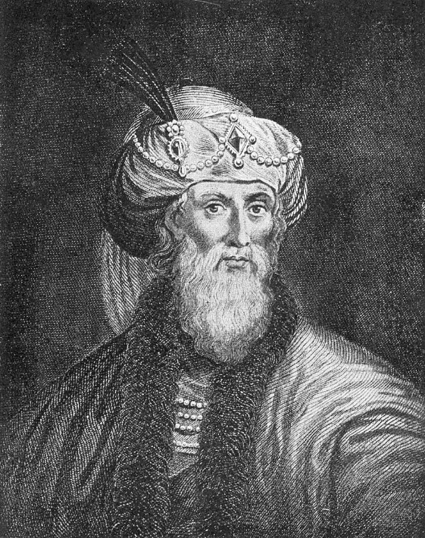
Mission
UNIT 23
1. Real world problem
1.1. Josephus story in the history
The Josephus story in the history has become an interesting coding problem.
Josephus was a Jewish historian in the 1st century. After being defeated from the war with Rome, all of the 41 people including him escaped into a cave.
In the cave, they stood in a circle and made an agreement that every 3rd person to commit suicide until no one survives.
Josephus thought killing themselves was meaningless, so he did calculation and occupied the position that will allow him to survive until the end. Then, the story says that he finally survived by convincing other remaining people.
https://en.wikipedia.org/wiki/Josephus#/media/File:Josephus.jpg

Slide 74
Mission
UNIT 23
1. Real world problem
1.1. Josephus story in the history
Let’s say a total of 7 people are sitting around the table.
Each of them is given with a number from 1 to 7 in clockwise. The following method will be used to select a representative.
1
7
2
Exclude every 3rd person from the table by starting with no.1 in clockwise.
Repeat the same method from the person who sits next to the one that was previously excluded.
6
3
5
4
If the above method is used to select one representative that remains the last, then who will be the one?

Slide 75
Mission
UNIT 23
1. Real world problem
1.1. Josephus story in the history
Josephus problem can be defined as follows.
𝑁 people gather around a table and each of them receives a number from 1 to N in clockwise.
Select 𝐾 that is smaller or identical to 𝑁, and exclude the Kth person from no.1.
Exclude the Kth person in clockwise until (𝑁−1) people are eliminated.
Calculate the number of the person who will survive until the last when two positive integers 𝑁 and 𝐾(≤𝑁) are given.

Slide 76
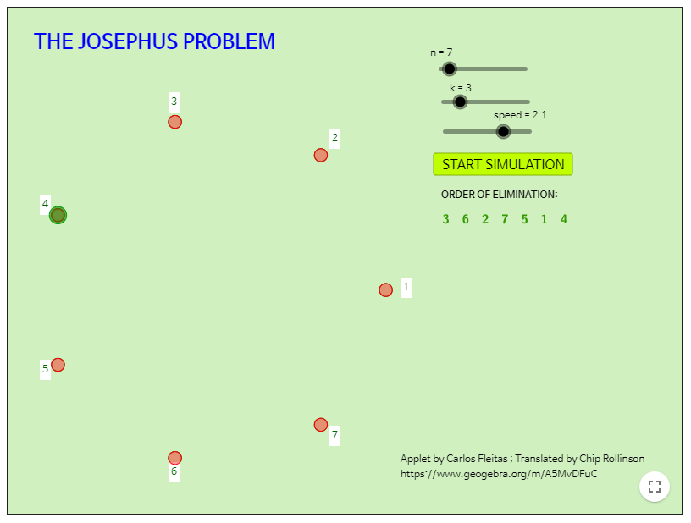
Mission
UNIT 23
1. Real world problem
1.2. Josephus sequence generator
GeoGebra provides an applet for simulating Josephus problem.
In the history, Josephus participated in a game in which every 3rd person kills oneself among 41 people sitting in a circle.
So, in Josephus problem, N=41 and K=3. Then, which number did Josephus have?
Josephus survived with another person who also survived until the last. Then, what would be his number?
Use the applet to check those two people who survived from the Josephus story.
https://www.geogebra.org/m/ExvvrBbR

Slide 77


Mission
UNIT 23
2. Mission
2.1. Josephus problem
The first problem that we had is Josephus problem where N=7, K=3.
To solve this problem, start with no.1 where 7 people are sitting around the table and exclude every 3rd person.
1
2
1
7
2
3
6
3
5
4

Slide 78
Mission
UNIT 23
2. Mission
2.1. Josephus problem
After no.3 is eliminated, the no.6 who is the 3rd person from no.4 should be excluded.
1
7
2
6
3
5
4
1
2

Slide 79
Mission
UNIT 23
2. Mission
2.1. Josephus problem
Once no.6 is eliminated, then the next 3rd person is no.2.
Exclude no.2 from the table.
2
3
1
7
2
1
5
4

Slide 80

Mission
UNIT 23
2. Mission
2.1. Josephus problem
Skip the person who is already excluded.
After no.2 is eliminated, the next 3rd person to be excluded is no.7. Eliminate no.7.
1
7
3
1
5
4
2

Slide 81

Mission
UNIT 23
2. Mission
2.1. Josephus problem
The same principle applies, and the next person to be eliminated next to no.7 is no.5.
Exclude no.5.
1
1
2
5
4
3

Slide 82

Mission
UNIT 23
2. Mission
2.1. Josephus problem
Only two people remain, so when starting from no.1, the 3rd person becomes no.1.
Thus, eliminate no.1.
1
2
3
1
4

Slide 83
Mission
UNIT 23
2. Mission
2.1. Josephus problem
After excluding no.1, only one person remains. The final representative is no.4.
4

Slide 84
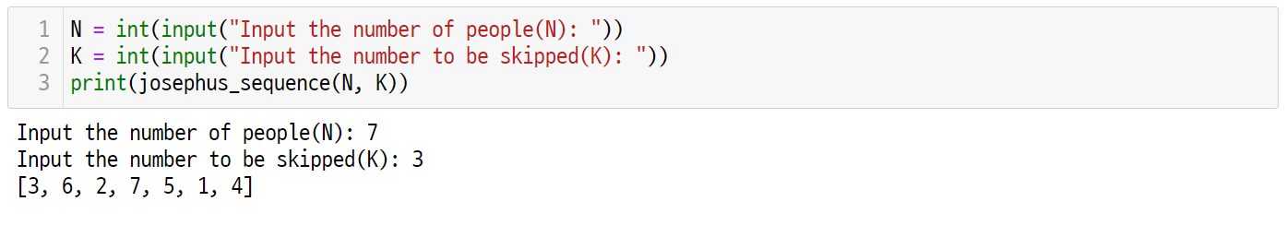
Mission
UNIT 23
3. Solution
3.1. How to solve the Josephus problem
Receive N and K as user input to print Josephus sequence.

Slide 85
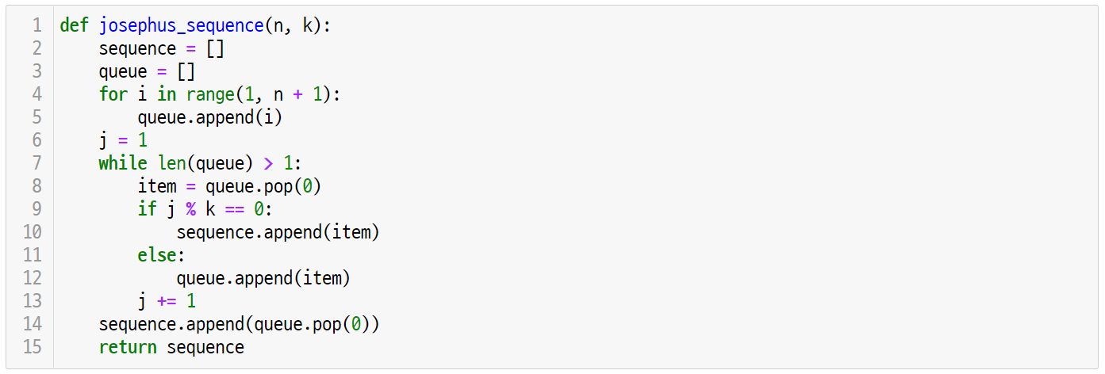
Mission
UNIT 23
3. Solution
3.2. Josephus problem final code

Slide 86
Unit 23.
Queue
Key concept

Slide 87
Key concept
UNIT 23
1. What is a Queue?
1.1. Definition of a queue
A queue is an abstract data type where only deletion is possible at the front and only addition is possible at the rear.
Because the first added item is also removed the first, a queue is a data structure that works with the FIFO (First-In-First-Out) method.
Focus
A queue should provide two important interfaces.
enqueue: adds a new item to the rear of the queue
dequeue: deletes an item from the front of the queue
rear
front
rear
front
X
C
B
A
enqueue
X
C
B
A
dequeue
queue
queue
A

Slide 88

Key concept
UNIT 23
1. What is a Queue?
1.2. Examples of a queue in our life
A queue is frequently found in our life.
For example, for flight booking at an airport, people need to wait in a queue, and the first person who entered the line receives the service first.
Other than this, queues are commonly found in restaurants and banks.

Slide 89
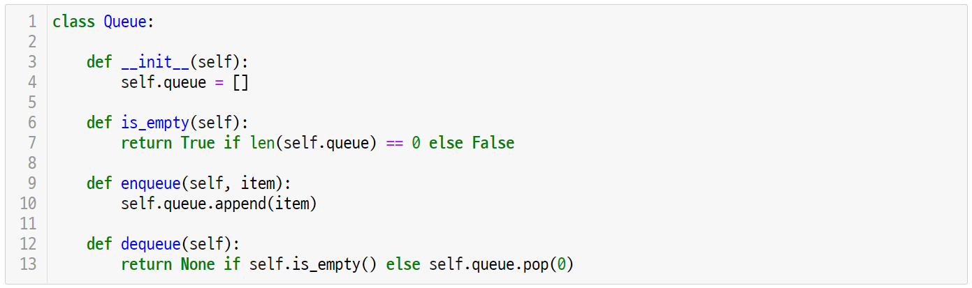
Key concept
UNIT 23
2. Implement a Stack
2.1. Define a queue as a class type
In Python, list data type can be used to define the queue data structure as a class.

Slide 90
Key concept
UNIT 23
2. Implement a Stack
2.1. Define a queue as a class type
Similar to the stack class, the queue class defines a queue as a list data type through the constructor method.
Line 1-4
Define the queue data structure as a queue class.
The __init__(self) constructor initiates the queue member field into an empty list.

Slide 91
Key concept
UNIT 23
2. Implement a Stack
2.1. Define a queue as a class type
The 'enqueue’ can be implemented as a method of the queue class as shown below.
Line 9-10
The enqueue() method receives the ’self’ and item to be added to the queue as parameters.
The ’enqueue’ adds an item to the end of the self.queue list which is the queue class member field.

Slide 92
Key concept
UNIT 23
2. Implement a Stack
2.1. Define a queue as a class type
The ‘dequeue’ can be implemented as a method of the stack class as shown below.
Line 12-13
The dequeue() method receives ‘self’ as a parameter.
The ‘dequeue’ returns None if self.is_empty() is True, and if not, it returns by deleting the last element of the self.queue.

Slide 93
Key concept
UNIT 23
2. Implement a Stack
2.1. Define a queue as a class type
The is_empty() method that is used to check for an empty queue should be also defined as the queue class method.
Line 6-7
The is_empty() method returns True if the self.queue length is 0, and if not, it returns False.

Slide 94
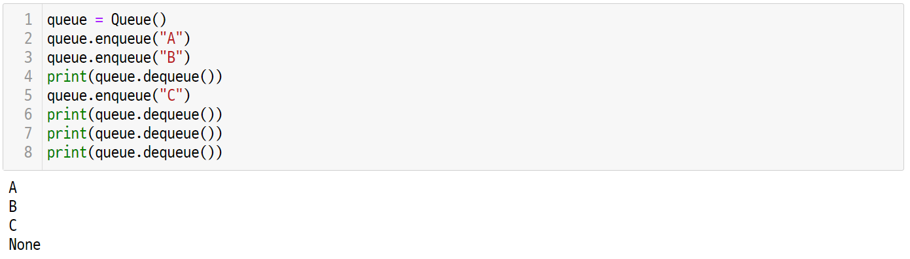
Key concept
UNIT 23
2. Implement a Stack
2.1. Define a queue as a class type
The following code tests the queue data structure that is defined as a class.
Line 1-8
The queue variable saves the object instance of the queue class that is created by calling the Queue() constructor.
The enqueue() and dequeue() methods of the queue object can be called by using the reference operator ‘.’
Print the returned value of the queue.dequeue() function as print() to check the order of removal from the queue.

Slide 95
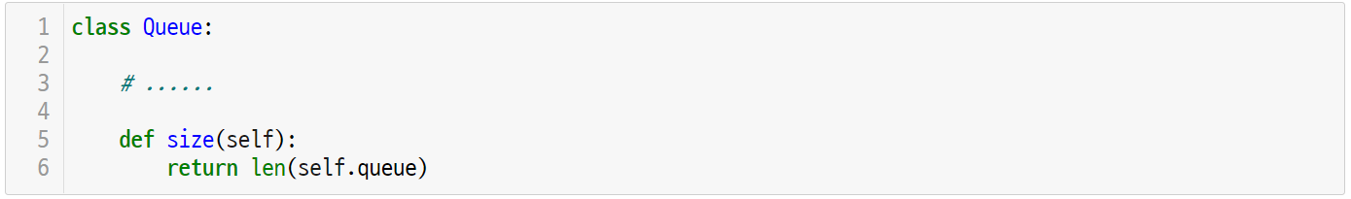
Key concept
UNIT 23
One More Step
What would you do if you want to know the number of elements in the queue?
The size() method that provides current number of elements in the queue can be implemented by returning the queue list length of the current queue class.

Slide 96
Unit 23.
Queue
Let’s code

Slide 97
Let’s code
UNIT 23
1. Josephus Problem
1.1. Problem definition
Calculate number of people being excluded when applying the following rule to two natural numbers N and K.
𝑁 people gather around a table and each of them is assigned with a number from 1 to N in clockwise.
For K that is smaller or identical to N, exclude the Kth person starting from no.1.
Eliminate Kth person in clockwise until everyone is excluded.
1
7
2
If N=7, K=3,
the order of elimination is [3, 6, 2, 7, 5, 1, 4]
6
3
5
4

Slide 98
Let’s code
UNIT 23
1. Josephus Problem
1.2. Solving the problem using a queue
Use the queue data structure to easily solve the Josephus problem.
First, enqueue from 1 to N to the queue in order.
If N=7, it will look like as follows.
Because nothing has been eliminated yet, the sequence is defined as an empty list.
rear
front
7
6
5
4
3
2
1
queue
sequence = []

Slide 99
Let’s code
UNIT 23
1. Josephus Problem
1.2. Solving the problem using a queue
Take one element from the queue and add it back to the queue. However, do not add the Kth element back to the queue.
Start by taking the first element and add no.1 back to the queue.
enqueue
rear
front
dequeue
7
6
5
4
3
2
1
1
before
count = 1
rear
front
1
7
6
5
4
3
2
after

Slide 100
Let’s code
UNIT 23
1. Josephus Problem
1.2. Solving the problem using a queue
When taking the 2nd element, add no.2 back to the queue.
enqueue
rear
front
dequeue
1
7
6
5
4
3
2
2
before
count = 2
rear
front
2
1
7
8
5
4
3
after

Slide 101
Let’s code
UNIT 23
1. Josephus Problem
1.2. Solving the problem using a queue
When taking the 3rd element, eliminate it without adding no.3 back to the queue.(K=3).
The eliminated no.3 should be added to the sequence list.
rear
front
dequeue
2
1
7
6
5
4
3
3
queue
count = 3
sequence = [3]

Slide 102
Let’s code
UNIT 23
1. Josephus Problem
1.2. Solving the problem using a queue
Next, take the elements no. 4 and 5 from the queue, then add them back to it.
enqueue
rear
front
dequeue
2
1
7
6
5
4
4
queue
count = 1
enqueue
rear
front
dequeue
4
2
1
7
6
5
5
queue
count = 2

Slide 103
Let’s code
UNIT 23
1. Josephus Problem
1.2. Solving the problem using a queue
No.6 is the 3rd element, so add it to the sequence list without adding it back to the queue.
rear
front
dequeue
5
4
2
1
7
6
6
queue
count = 3
sequence = [3, 6]

Slide 104
Let’s code
UNIT 23
1. Josephus Problem
1.2. Solving the problem using a queue
After taking no.7 and 1, add them back to the queue.
enqueue
rear
front
dequeue
5
4
2
1
7
7
queue
count = 1
enqueue
rear
front
dequeue
7
5
4
2
1
1
queue
count = 2

Slide 105
Let’s code
UNIT 23
1. Josephus Problem
1.2. Solving the problem using a queue
No.2 is the element where K=3, so add it to the sequence list, not to the queue.
rear
front
dequeue
1
7
5
4
2
2
queue
count = 3
sequence = [3, 6, 2]

Slide 106
Let’s code
UNIT 23
1. Josephus Problem
1.2. Solving the problem using a queue
Repeat the same process until one element remains in the queue.
enqueue
rear
front
dequeue
1
7
5
4
4
queue
count = 1
enqueue
rear
front
dequeue
4
1
7
5
5
queue
count = 2

Slide 107
Let’s code
UNIT 23
1. Josephus Problem
1.2. Solving the problem using a queue
Repeat the same process until one element remains in the queue.
rear
front
dequeue
5
4
1
7
7
queue
count = 3
sequence = [3, 6, 2, 7]

Slide 108
Let’s code
UNIT 23
1. Josephus Problem
1.2. Solving the problem using a queue
Repeat the same process until one element remains in the queue.
enqueue
rear
front
dequeue
5
4
1
1
queue
count = 1
enqueue
rear
front
dequeue
1
5
4
4
queue
count = 2

Slide 109
Let’s code
UNIT 23
1. Josephus Problem
1.2. Solving the problem using a queue
Repeat the same process until one element remains in the queue.
rear
front
dequeue
4
1
5
5
queue
count = 3
sequence = [3, 6, 2, 7, 5]

Slide 110
Let’s code
UNIT 23
1. Josephus Problem
1.2. Solving the problem using a queue
Repeat the same process until one element remains in the queue.
enqueue
rear
front
dequeue
4
1
1
queue
count = 1
enqueue
rear
front
dequeue
1
4
4
queue
count = 2

Slide 111
Let’s code
UNIT 23
1. Josephus Problem
1.2. Solving the problem using a queue
Repeat the same process until one element remains in the queue.
rear
front
dequeue
4
1
1
queue
count = 3
sequence = [3, 6, 2, 7, 5, 1]

Slide 112
Let’s code
UNIT 23
1. Josephus Problem
1.2. Solving the problem using a queue
If only one element remains in the queue, dequeue it and add it as the last element of the sequence list.
front rear
dequeue
4
queue
sequence = [3, 6, 2, 7, 5, 1, 4]

Slide 113
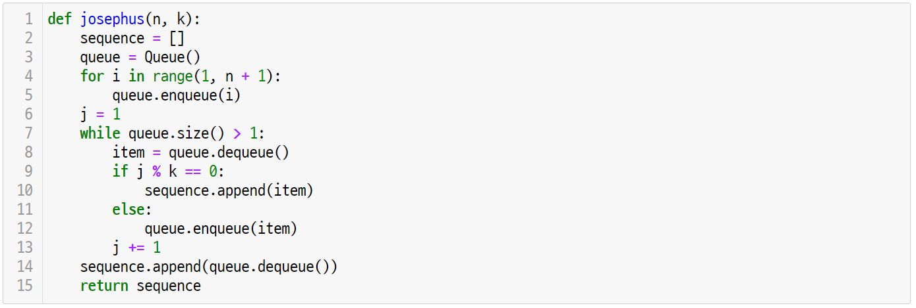
Let’s code
UNIT 23
1. Josephus Problem
1.3. Implementation and coding
Implement the previous steps into Python codes. First, the josepush() function receives integers n and k as input parameters.
Line 1-3
The josephus() function returns Josephus permutation into a list through the input parameters n and k.
The returning sequence is initialized as an empty list, while the queue is initialized as an object of the queue class that was previously defined.

Slide 114
Let’s code
UNIT 23
1. Josephus Problem
1.3. Implementation and coding
Line 4-5
Enqueue integers from 1 to N to the first queue.

Slide 115
Let’s code
UNIT 23
1. Josephus Problem
1.3. Implementation and coding
Line 6-7, 13
‘j’ is a counter that takes an item out of the queue. Thus, it processes initialization with 1.
Then, increase the j value by 1 to repeat enqueue and dequeue until only one item remains in the queue.
If the remainder of dividing j with k is 0, then this item is the next kth one which will be dequeued.

Slide 116
Let’s code
UNIT 23
1. Josephus Problem
1.3. Implementation and coding
Line 8-12
Dequeue one item from the queue.
If j % k == 0, then it is the kth item, so add an element to the end of the sequence.
If j % k != 0, then this item won’t be dequeued, so add it back to the queue.
Repeat the process until only one element remains in the queue, and the dequeued elements are saved in the sequence list.

Slide 117
Let’s code
UNIT 23
1. Josephus Problem
1.3. Implementation and coding
Line 14-15
Once the while loop is complete, only one element remains in the queue, which will be dequeued for the last.
Thus, it is possible to print the sequence by taking the element from the queue and adding it to the end of the sequence.

Slide 118
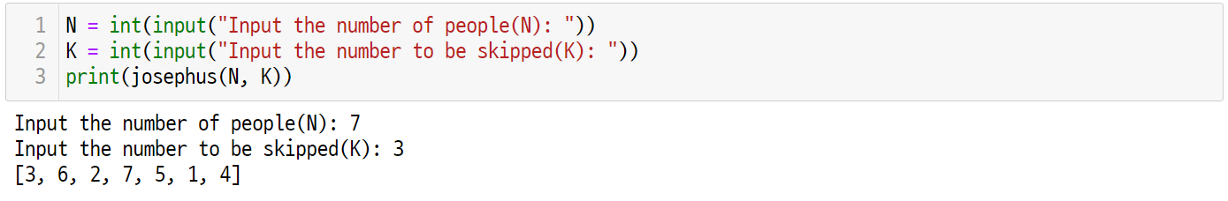
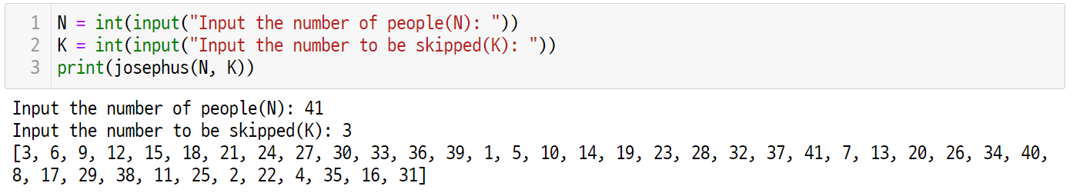
Let’s code
UNIT 23
1. Josephus Problem
1.3. Implementation and coding
Apply the previous example to the josephus() function to obtain the following results.

Slide 119
Unit 23.
Queue
Pop quiz

Slide 120
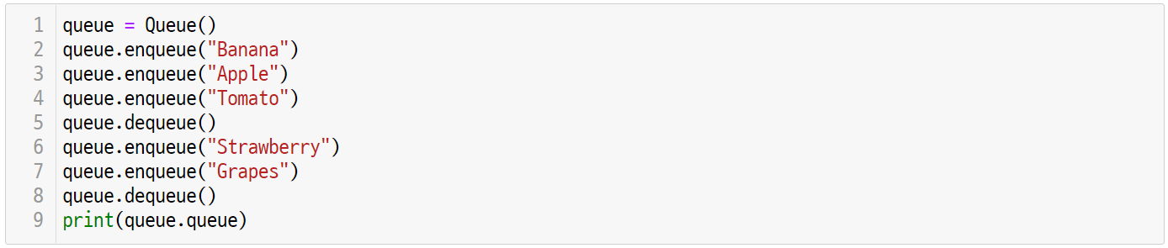
Pop quiz
UNIT 23
Quiz. #1
Write the output of the codes from the example that uses a stack.
Notes:
Answer: ['Tomato', 'Strawberry', 'Grapes']

Slide 121
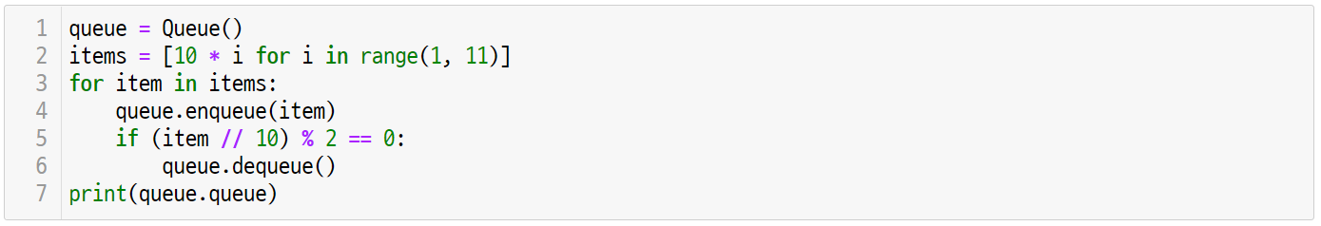
Pop quiz
UNIT 23
Quiz. #2
Write the output of the codes from the example that uses a stack.
Notes:
Answer: [60, 70, 80, 90, 100].

Slide 122
Unit 23.
Queue
Pair programming

Slide 123
Pair programming
UNIT 23

Slide 124
Pair programming
UNIT 23

Slide 125
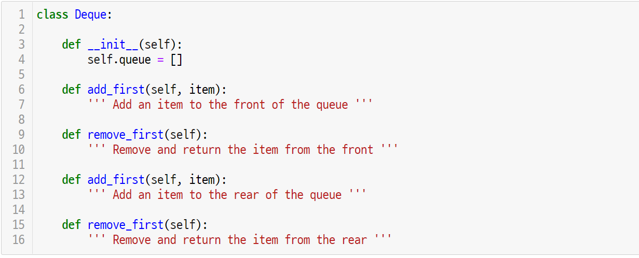
Pair programming
UNIT 23
Refer to the class definition as follows to complete and test the Deque class.
Notes:
Deque는 dequeue와의 혼란을 피하기 위해 ‘deck’으로 발음한다.

Slide 126
Pair programming
UNIT 23
TIP
A queue is an abstract data type where only addition is possible on one side and only removal is possible on the other side. In contrast, the Double Ended Queue (Deque) is the data structure where addition and removal are possible on both sides.
Y
rear
front
X
add_last
add_first
Y
…
X
remove_last
queue
remove_first
Y
X

Slide 127
Unit 24.
Sequential Search

Slide 128
Unit learning objective (1/3)
UNIT 24
Learning objectives
Understand searching problems and be able to solve them through sequential search.
Be able to implement sequential search algorithms through Python language.
Be able to apply sequential search algorithms to solve problems that find maximum and 2nd maximum values.

Slide 129
Unit learning objective (2/3)
UNIT 24
Learning overview
Understand searching problems that find a specified element from randomly arranged data.
Learn how to solve searching problems through sequential search.
Learn how to write sequential search algorithms with Python, and analyze the best, worst, and average time complexity.
Concepts You Will Need to Know From Previous Units
How to traverse the list elements through iterator
How to compare the size of list elements
How to use Big-O notation to express time complexity of the algorithm

Slide 130
Unit learning objective (3/3)
UNIT 24
Keywords
Searching
Problem
Sequential
Search
Linear Time

Slide 131
Unit 24.
Sequential Search
Mission

Slide 132


Mission
UNIT 24
1. Real world problem
1.1. Egg dropping challenge
The egg dropping challenge is designed for students who like science.
Students should make an egg-protection device to prevent breaking of the egg even if falling from a high place.
Imagine that you participated in the egg dropping challenge and made an egg-protection device with a great idea.
How would you do if you want to calculate the highest floor that won’t break your egg on a 100-floor building?
Let’s create an algorithm to solve the egg dropping problem.

Slide 133
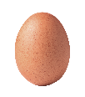
Mission
UNIT 24
2. Mission
2.1. Egg dropping problem
Find the highest floor for not breaking the egg when the max. building floor is given.
The highest floor for not breaking the egg is determined by a random number between the 1st to the max. floor of the building through a random function. Because there is only one egg, assume that you cannot proceed the experiment if it breaks.
If the egg is not broken, you can repeat the experiment. So, test from the 1st to the max. floor and find the floor that is one less than the floor where the egg breaks for the first time.
However, if the egg doesn’t break even from the max. floor, return the max. floor value of the building, and return 0 if the egg breaks from the 1st floor.
Floor n
?
x

Slide 134
Mission
UNIT 24
2. Mission
2.1. Egg dropping problem
Experiment on a building where N=10.
Assume that the egg doesn’t break when falling from the 5th floor or lower, and it breaks when falling from the 6th floor or higher. Thus, the egg won’t break when doing an experiment on the 1st floor.
height
10
9
8
7
6
breaking
5
4
3
2
Experiment will succeed
1

Slide 135
Mission
UNIT 24
2. Mission
2.1. Egg dropping problem
Proceed the experiment by going up each floor, and the experiment will succeed without breaking the egg.
height
10
9
8
7
6
breaking
Experiment will succeed
5
Experiment will succeed
4
Experiment will succeed
3
Experiment will succeed
2
Experiment will succeed
1

Slide 136
Mission
UNIT 24
2. Mission
2.1. Egg dropping problem
Doing an experiment on the 6h floor will break the egg.
So, 5th floor is the highest floor where the egg doesn’t break.
height
10
9
8
7
Experiment will fail
6
breaking
return 5
5
4
3
2
1

Slide 137
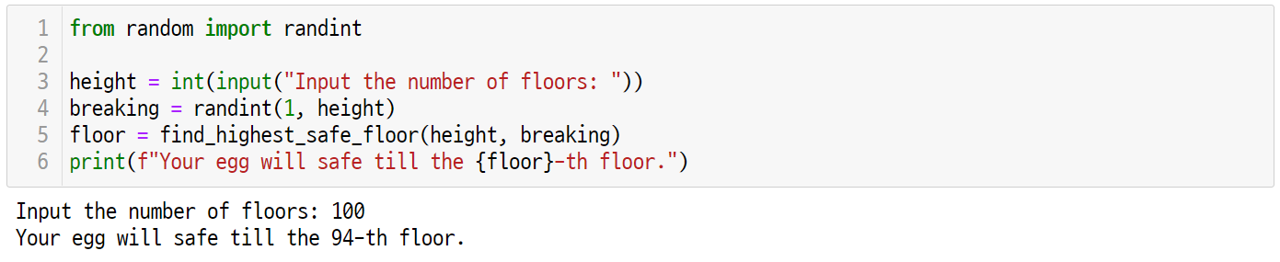
Mission
UNIT 24
3. Solution
3.1. How the solution works
The egg dropping problem finds the height where the egg breaks by receiving the building ‘height’ as user input.

Slide 138
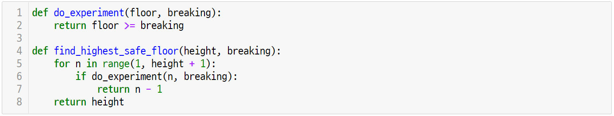
Mission
UNIT 24
3. Solution
3.2. Egg dropping problem final code

Slide 139
Unit 24.
Sequential Search
Key concept

Slide 140
Key concept
UNIT 24
1. Searching Problem
1.1. Two types of searching
In computer programming, one of the most frequently done processes is to find a specified item in given data.
If the given data does not have any rules, you need to check all of it. For instance, consider a problem to find the location of a random value x from the list S where N integers are randomly listed. What if x does not exist in the given list S? You won’t be able to find the location of x until checking all of the elements in S.
If the given data has rules, the searching problem can be more efficiently solved. For example, if the given data is an ordered sequence, the binary search can be used which will be discussed later.
Sequential
Search
vs.
Binary
Search

Slide 141


Key concept
UNIT 24
1. Searching Problem
1.2. Sequential search
Sequential search refers to an algorithm that does investigation by checking all of the items one by one in order.
Sequential search is done for randomly given data. So, because searching is done without any rules, it is also referred to ‘finding a needle in a haystack.’

Slide 142
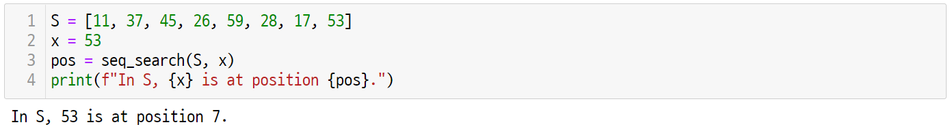
Key concept
UNIT 24
2. Sequential Search
2.1. An algorithm for the sequential search
Consider a sequential search algorithm that finds a specific integer in the given list of integers.
Focus
The following shows the sequential search algorithm problem, and its input and output.
Problem: Does a random integer x exist in the S, the set of given integers?
Input: S as the list of integers, x as a random integer to find.
Output: The index location if x exists in the list S, and -1 if it does not exist.

Slide 143
Key concept
UNIT 24
2. Sequential Search
2.2. An algorithm for the sequential search
Sequential search algorithm compares the x value to find with each of the element in the given list S.
When starting the sequential search, it returns index 0 if the value is the same as the first element, and if not, it makes another comparison with next element.
0
1
2
3
4
5
6
7
S:
11
37
45
26
59
28
17
53
!=
x
45

Slide 144
Key concept
UNIT 24
2. Sequential Search
2.3. An algorithm for the sequential search
If the value is not the same as the next element S[1], move to the next one.
0
1
2
3
4
5
6
7
S:
11
37
45
26
59
28
17
53
!=
x
45

Slide 145
Key concept
UNIT 24
2. Sequential Search
2.3. An algorithm for the sequential search
The x value is the same as the element S[2], so it returns 2 and finishes,
0
1
2
3
4
5
6
7
S:
11
37
45
26
59
28
17
53
==
return 2
x
45

Slide 146
Key concept
UNIT 24
2. Sequential Search
2.3. An algorithm for the sequential search
In the sequential search, if the element to find is S[0] which is the first one, only one comparison operation can be done to finish search, which is referred to ’base-case.’
0
1
2
3
4
5
6
7
S:
11
37
45
26
59
28
17
53
!=
return 0
x
11

Slide 147
Key concept
UNIT 24
2. Sequential Search
2.3. An algorithm for the sequential search
In sequential search, if the element to find does not exist in S, comparison must be done to all elements of S.
If there are n elements in S, a total of n comparison operation should be done. If so, it is called ‘worst-case.’
0
1
2
3
4
5
6
7
S:
11
37
45
26
59
28
17
53
!=
!=
!=
!=
!=
!=
!=
!=
return -1
x
88
88
88
88
88
88
88
88
88

Slide 148
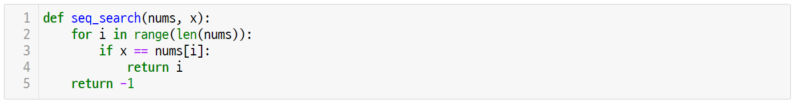
Key concept
UNIT 24
2. Sequential Search
2.4. Implement the sequential search
Sequential search algorithm can be implemented as follows.
Receive ’nums’ and x as input to proceed with sequential searching of the elements in nums.
Line 2-5
Line 2 is the for-loop for sequential searching of elements in nums.
Line 3 and 4 return ‘i’ if the nums[i] and x value are the same.
Line 5 returns -1 because nums does not have x.

Slide 149
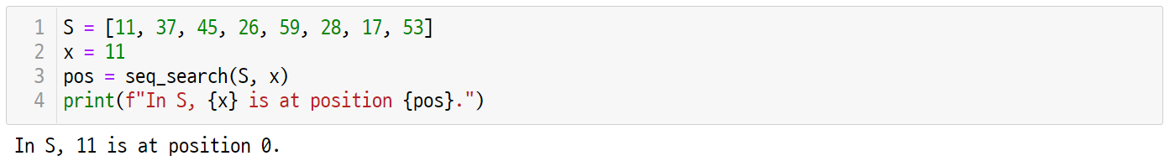
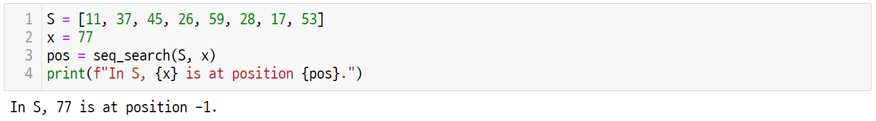
Key concept
UNIT 24
2. Sequential Search
2.4. Implement the sequential search
The seq_search() function that was implemented previously can be applied to find list elements as follows.

Slide 150
Key concept
UNIT 24
One More Step
What is the time complexity of sequential search? Analyze with Big-O notation.
First, in the best-case, searching is finished after a single comparison, so it is certainly O(1). Also, comparison for n times is required in the worst-case, so it is clearly O(n).
How is the average time complexity of sequential search analyzed? Assume that S has N elements. When searching every element of S one by one, calculate how many comparison operations (==) should be done.
Assign 1 for the first element and 2 for the second element, and so on. For Nth element, N times of comparison operations should be done. Thus, the number of comparison operation required to search every element once is N(N+1)/2.
$$1+2+…+N=\frac{N(N+1)}{2}$$
So, the average search time T(n) to all elements is O(n), which is linear search time.
$$T\left(N\right)=\frac{N(N+1)}{2}÷N=\frac{N+1}{2}∈Ο(n)$$

Slide 151
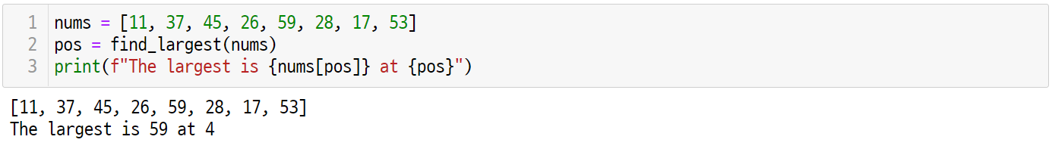
Key concept
UNIT 24
3. Finding the Largest
3.1. An algorithm for finding the largest key
Consider an algorithm that finds the largest key in the list of given integers.
Focus
The following is the input and output of the algorithm problem to find the largest key.
Problem: Where is the largest key in the S, a set of given integers?
Input: S as the list of integers
Output: Largest index among the elements in S

Slide 152
Key concept
UNIT 24
3. Finding the Largest
3.1. An algorithm for finding the largest key
The largest key finding algorithm can be implemented in a similar way as the sequential search algorithm, First, assume that the location of the largest key is the first element of S.
$$i$$
0
0
1
2
3
4
5
6
7
S:
11
37
45
26
59
28
17
53
$$largest$$
0
$$S[largest]$$
11
$$S[i]$$
11

Slide 153
Key concept
UNIT 24
3. Finding the Largest
3.1. An algorithm for finding the largest key
When comparing S[1] with the current largest S[largest], because S[1] is larger than S[0], the location of the largest key should be changed to 1.
$$i$$
1
0
1
2
3
4
5
6
7
S:
11
37
45
26
59
28
17
53
$$largest$$
0
$$S[largest]$$
11
$$S[i]$$
37

Slide 154
Key concept
UNIT 24
3. Finding the Largest
3.1. An algorithm for finding the largest key
When comparing S[2] with the current largest S[largest], because S[2] is larger than S[1], the location of the largest key should be changed to 2.
$$i$$
2
0
1
2
3
4
5
6
7
S:
11
37
45
26
59
28
17
53
$$largest$$
1
$$S[largest]$$
37
$$S[i]$$
45

Slide 155
Key concept
UNIT 24
3. Finding the Largest
3.1. An algorithm for finding the largest key
When comparing S[3] with the current largest S[largest], because S[3] is smaller than S[2], the location of the largest key does not change.
$$i$$
3
0
1
2
3
4
5
6
7
S:
11
37
45
26
59
28
17
53
$$largest$$
2
$$S[largest]$$
45
$$S[i]$$
26

Slide 156
Key concept
UNIT 24
3. Finding the Largest
3.1. An algorithm for finding the largest key
When comparing S[4] with the current largest S[largest], because S[4] is larger than S[2], the location of the largest key should be changed to 4.
$$i$$
4
0
1
2
3
4
5
6
7
S:
11
37
45
26
59
28
17
53
$$largest$$
2
$$S[largest]$$
45
$$S[i]$$
59

Slide 157
Key concept
UNIT 24
3. Finding the Largest
3.1. An algorithm for finding the largest key
If there is no value that is larger than S[largest], the location of the largest key remains the same.
$$i$$
5
0
1
2
3
4
5
6
7
S:
11
37
45
26
59
28
17
53
$$largest$$
4
$$S[largest]$$
59
$$S[i]$$
28

Slide 158
Key concept
UNIT 24
3. Finding the Largest
3.1. An algorithm for finding the largest key
If there is no value that is larger than S[largest], the location of the largest key remains the same.
$$i$$
6
0
1
2
3
4
5
6
7
S:
11
37
45
26
59
28
17
53
$$largest$$
4
$$S[largest]$$
59
$$S[i]$$
17

Slide 159
Key concept
UNIT 24
3. Finding the Largest
3.1. An algorithm for finding the largest key
If there is no value that is larger than S[largest], the location of the largest key remains the same.
$$i$$
7
0
1
2
3
4
5
6
7
S:
11
37
45
26
59
28
17
53
$$largest$$
4
$$S[largest]$$
59
$$S[i]$$
53

Slide 160
Key concept
UNIT 24
3. Finding the Largest
3.1. An algorithm for finding the largest key
The largest value has max. index after finish searching all elements, so it returns largest.
$$i$$
0
1
2
3
4
5
6
7
S:
11
37
45
26
59
28
17
53
$$largest$$
4
return 4
$$S[largest]$$
$$S[i]$$

Slide 161
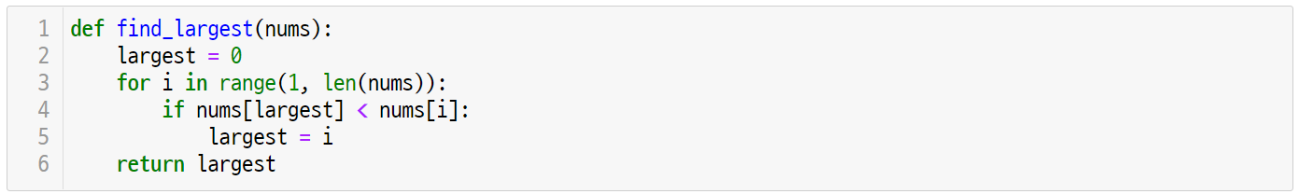
Key concept
UNIT 24
3. Finding the Largest
3.2. Implementation and coding
Apply the previously used strategy to implement the find_largest() function as follows.
Line 2-5
Initialize the index of the first element in the nums list into the largest value.
Compare the current nums[largest] value and nums[i] value from the 2nd element to the last element of the nums list.
If the ‘i’ value is greater than the largest value, update the largest into ‘i.’

Slide 162
Key concept
UNIT 24
3. Finding the Largest
3.2. Implementation and coding
Line 6
The largest value after finishing searching is the index value of the largest element in the nums.

Slide 163
Unit 24.
Sequential Search
Let’s code

Slide 164
Let’s code
UNIT 24
1. Egg Dropping Problem
1.1. Problem Definition
Write an algorithm to find the highest floor that does not break the egg when dropping it if the building height is given.
The algorithm implementation conditions are as follows.
1. The ‘breaking,’ which is the lowest floor where the egg breaks, is randomly selected between 1 and height.
2. The egg dropping experiment is expressed as do_experiment(floor).
3. However, the program must be closed when the do_experiment() function calls True.
Return True if the egg breaks when dropping from the floor.
If not, return False.

Slide 165
Let’s code
UNIT 24
1. Egg Dropping Problem
1.2. Implementation and Coding
Receive the user input regarding the building ’height’ through the input() function.
Line 3
Convert the input type received by input() function into int() function and allocate it to variable ‘height.’

Slide 166
Let’s code
UNIT 24
1. Egg Dropping Problem
1.2. Implementation and Coding
Create a random number between 1 and height and allocate it to the variable ‘breaking.’
Line 1, 4
For random creation of integers in a range, use the randint() function in the random module.
The randint(a, b) function returns a random integer in the range from a and b (same or greater than ‘a’ and same or smaller than ‘b’).

Slide 167
Let’s code
UNIT 24
1. Egg Dropping Problem
1.2. Implementation and Coding
Implement a function that returns the highest floor where the egg does not break.
Line 5-6
The find_highest_safe_floor() function returns the highest floor where the egg does not break.
Print the string format by using f-string. The f-string adds ‘f’ in front of the string, and applies {} on the converted variable within the string.

Slide 168
Let’s code
UNIT 24
1. Egg Dropping Problem
1.2. Implementation and Coding
Implement the do_experiment() function for egg dropping experiment.
Line 1-2
The ‘breaking’ variable is the lowest floor where the egg breaks.
Thus, if the floor value as input parameter is same or greater than the breaking value, it returns True, and if not, it returns False.

Slide 169
Let’s code
UNIT 24
1. Egg Dropping Problem
1.2. Implementation and Coding
Find the highest floor where the egg does not break in the egg dropping experiment by using ‘height’ and ‘breaking’ information.
Line 4-8
Repeat the egg dropping experiment from 1st to ’height’ floor, and if the egg breaks, then return the n-1 floor.
If experiment is successful at all floors, then return the highest floor ‘height.’

Slide 170
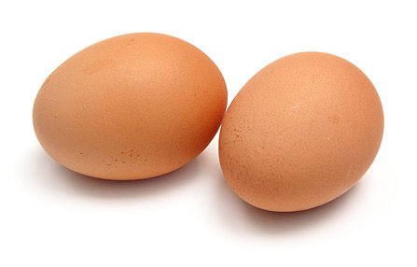
Let’s code
UNIT 24
One More Step
What is the time complexity of the egg dropping problem?
If there is only one egg, similar to the sequential search, the best-case is O(1) while the worst-case is O(n). The average time complexity will be also O(n).
What if there are infinite number of eggs so that breaking an egg during the experiment doesn’t matter?
When there are infinite number of eggs, it is possible to use the binary search which will be discussed later. The average time complexity will be O(logn).
How many experiments should be done at least if there are two eggs?
This problem is called two-eggs problems, and at least 14 experiments can be done on a 100th floor building as the worst-case.

Slide 171
Unit 24.
Sequential Search
Pop quiz

Slide 172
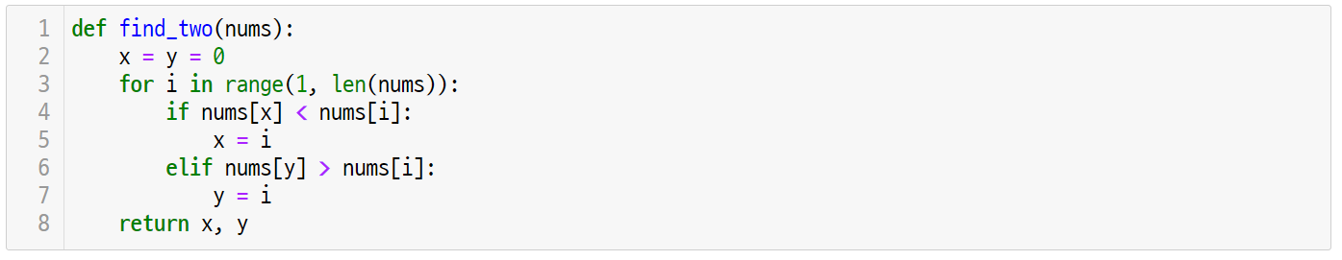
Pop quiz
UNIT 24
Quiz. #1
Guess the output of the following algorithm. Analyze the code and describe the behavior of this algorithm.

Slide 173
Pop quiz
UNIT 24
Quiz. #2
How many comparisons should be done for the find_two() that was implemented in quiz #1?

Slide 174
Unit 24.
Sequential Search
Pair programming

Slide 175
Pair programming
UNIT 24

Slide 176
Pair programming
UNIT 24

Slide 177
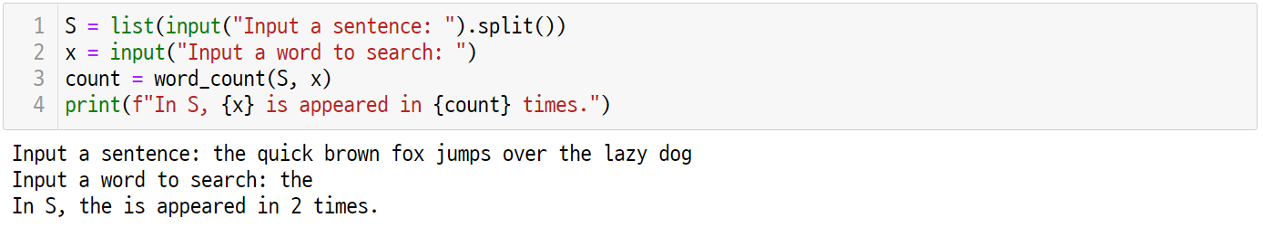
Pair programming
UNIT 24
Write a program to count how many times a specific word was used in the sentence entered by the user.
In the sentence entered by the user, a word is distinguished by the presence of spacing.
Use the input().split() function to create the list S that has each string as its element.
Use the input() function to receive the word that will be searched by the user and save it to x.
The word_count() function receives S and x as parameters and provides a return by counting how many x are present in the S.
Notes:
def word_count(S, x):
count = 0
for word in S:
if word == x:
count += 1
return count

Slide 178
Unit 25.
Binary Search

Slide 179
Unit learning objective (1/3)
UNIT 25
Learning objectives
Understand the searching problems and be able to solve them through binary search.
Be able to implement binary search algorithm with Python language.
Be able to understand and explain the time complexity of binary search algorithm.

Slide 180
Unit learning objective (2/3)
UNIT 25
Learning overview
Understand searching problems that find a specified element from orderly arranged data.
Learn how to solve searching problems of ordered data through binary search.
Learn how to write binary search algorithms with Python, and analyze the best, worst, and average time complexity.
Concepts You Will Need to Know From Previous Units
How to compare the size of list elements
How to make recurrence relation and solve a problem with a recursive function
How to express the time complexity of an algorithm by using Big-O notation

Slide 181
Unit learning objective (3/3)
UNIT 25
Keywords
Searching
Problem
Binary Search
Logarithmic Time

Slide 182
Unit 25.
Binary Search
Mission

Slide 183
Mission
UNIT 25
1. Real world problem
1.1. Egg dropping challenge revisited
Let’s participate in the egg dropping challenge again.
In the last challenge, there was only one egg, so we tried to calculate the highest floor where the egg does not break for the first time.
This time, there are sufficient number of eggs, meaning that you can keep doing experiments regardless of breaking eggs.
If there are sufficient eggs, the egg dropping problem can be more effectively solved compared to the sequential search.
Try to solve the egg dropping problem with binary search.

Slide 184
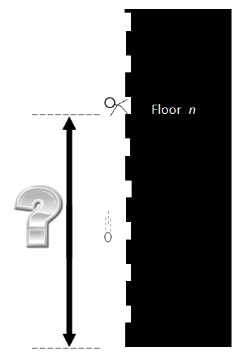



Mission
UNIT 25
2. Mission
2.1. Egg dropping problem with infinite eggs
x
If the building’s highest floor and the lowest floor where the egg breaks are given, find the highest floor where the egg does not break.
Since there are infinite eggs, assume that you can continue experimenting even if eggs break.
If you can continue experimenting even if eggs break, if an egg breaks at the mid-floor of the building, then the solution will be downstairs. Likewise, if an egg does not break at the mid-floor of the building, then the solution will be upstairs.
Apply the same method to halve the space for finding the solution.
This kind of method is called binary search.
Floor n

Slide 185
Mission
UNIT 25
2. Mission
2.1. Egg dropping problem with infinite eggs
Do an experiment at a building where N=10.
Assume that dropping an egg at floors lower than the 6th floor does not break an egg, and dropping it at floors higher than the 7th floor breaks an egg.
height
10
9
8
7
breaking
6
5
4
3
2
1

Slide 186
Mission
UNIT 25
2. Mission
2.1. Egg dropping problem with infinite eggs
First, let’s do an experiment at 5th floor that is the midpoint of the 1st and 10th floors.
If the egg doesn’t break, the floor where the egg breaks will be higher than the 5th floor.
high
10
9
8
These floors should be searched.
7
6
mid
5
Experiment will succeed.
4
3
These floors are safe.
2
low
1

Slide 187
Mission
UNIT 25
2. Mission
2.1. Egg dropping problem with infinite eggs
Now, the section we will investigate is from 6th to 10th floors.
Similarly, if an egg breaks at the 8th floor which is the midpoint, then the first floor where the egg breaks would be the 8th floor or downstairs.
high
10
9
These floors are not safe.
mid
8
Experiment will fail.
7
These floors should be searched.
low
6
5
4
3
2
1

Slide 188
Mission
UNIT 25
2. Mission
2.1. Egg dropping problem with infinite eggs
The next section we will investigate is from 6th to 8th floors.
Similarly, if an egg breaks at the 7th floor which is the midpoint, then the first floor where the egg breaks would be the 7th floor or downstairs.
10
9
high
8
This floor is not safe.
mid
7
low
These floors should be searched.
6
5
4
3
2
1

Slide 189
Mission
UNIT 25
2. Mission
2.1. Egg dropping problem with infinite eggs
We will now try 6th and 7th floors.
Assume that the midpoint is 6th floor, and if an egg does not break from the 6th floor, then the first floor where the egg breaks will be higher than the 6th floor.
10
9
8
high
7
This floor should be searched.
low, mid
6
This floor is safe.
5
4
3
2
1

Slide 190
Mission
UNIT 25
2. Mission
2.1. Egg dropping problem with infinite eggs
The next section is 7th floor.
Only one floor is remained to check, and since we’ve been searching for the lowest floor where an egg breaks, the 6th floor is considered as the highest floor where the egg does not break.
10
9
8
high, low
7
This floor is not safe.
6
5
4
3
2
1

Slide 191
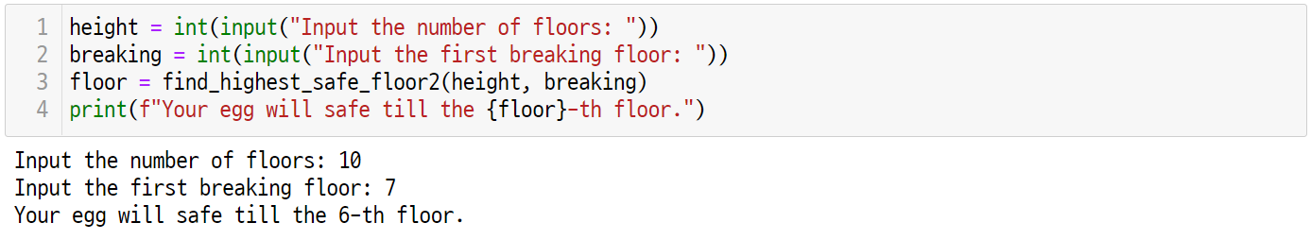
Mission
UNIT 25
3. Solution
3.1. How the solution works
Receive the user input regarding the building height and the floor where the egg breaks to find the highest floor where the egg does not break.

Slide 192
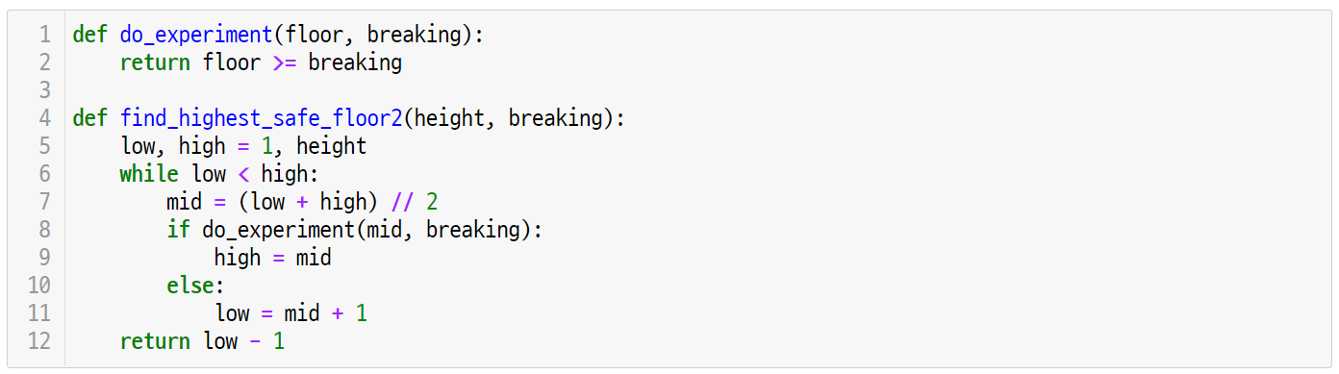
Mission
UNIT 25
3. Solution
3.2. Egg dropping problem final code

Slide 193
Unit 25.
Binary Search
Key concept

Slide 194

Key concept
UNIT 25
1. Binary Search
1.1. An algorithm for the binary search
Consider the binary search algorithm that finds a specific integer from the list of ordered integers.
Focus
The following is the binary search algorithm problem, and its input and output.
Problem: Does a random integer x exist in the S, a set of ordered integers?
Input: S as the list of integers arranged in ascending order, x as the random integer to find
Output: The index location if x exists in the list S, and -1 if it does not exist.

Slide 195
Key concept
UNIT 25
1. Binary Search
1.1. An algorithm for the binary search
The binary search algorithm searches x value in the given list S.
The initial search space is between the low and high (low as the 1st element index and high as the last element index) in S.
low
high
0
1
2
3
4
5
6
7
S:
11
17
26
28
37
45
53
59
search space
x
37

Slide 196
Key concept
UNIT 25
1. Binary Search
1.1. An algorithm for the binary search
In the binary search algorithm, the input list is arranged in ascending order.
Compare the x value with mid value that is in the middle of low and high.
low
mid
high
0
1
2
3
4
5
6
7
S:
11
17
26
28
37
45
53
59
<
x
37

Slide 197
Key concept
UNIT 25
1. Binary Search
1.1. An An algorithm for the binary search
If S[mid] is smaller than x, the x to find would be in between mid+1 and high.
Thus, low should be changed to mid+1, which halves the search space from [0, 7] to [4, 7].
mid
low
high
0
1
2
3
4
5
6
7
S:
11
17
26
28
37
45
53
59
search space
x
37

Slide 198
Key concept
UNIT 25
1. Binary Search
1.1. An algorithm for the binary search
Calculate the ‘mid’ which is in between the low and high to compare S[mid] and x.
S[mid] is greater than x, so high should be changed to mid-1.
low
mid
high
0
1
2
3
4
5
6
7
S:
11
17
26
28
37
45
53
59
>
x
37

Slide 199
Key concept
UNIT 25
1. Binary Search
1.1. An algorithm for the binary search
The search space is reduced from [4, 7] to [4, 4].
low,
high
mid
0
1
2
3
4
5
6
7
S:
11
17
26
28
37
45
53
59
search space
x
37

Slide 200
Key concept
UNIT 25
1. Binary Search
1.1. An algorithm for the binary search
Calculate the ‘mid’ which is in between the low and high to compare S[mid] and x.
Since the S[mid] and x values are the same, return the mid value at current location.
low, high, mid
0
1
2
3
4
5
6
7
S:
11
17
26
28
37
45
53
59
==
return 4
x
37

Slide 201
Key concept
UNIT 25
1. Binary Search
1.1. An algorithm for the binary search
If the value to find does not exist, for instance 31, because x is smaller than S[mid], high would change to mid-1.
The low < high condition does not satisfy, so break the while statement and return -1.
high
low
0
1
2
3
4
5
6
7
S:
11
17
26
28
37
45
53
59
>
x
31

Slide 202
Key concept
UNIT 25
1. Binary Search
1.2. An algorithm for the binary search
What would be the best-case in binary search? When you’re lucky to search the mid value in the S, only one comparison can be done to find the element.
low
mid
high
0
1
2
3
4
5
6
7
S:
11
17
26
28
37
45
53
59
==
x
28

Slide 203
Key concept
UNIT 25
1. Binary Search
1.2. An algorithm for the binary search
What would be the worst-case in binary search? Similar to sequential search, highest number of comparison must be done to search for an element that does not exist in S.
In the following example, a total of 4 comparison operations should be done to search for 77.
x
77
11
17
26
28
37
45
53
59
11
17
26
28
37
45
53
59
11
17
26
28
37
45
53
59
11
17
26
28
37
45
53
59
11
17
26
28
37
45
53
59

Slide 204

Key concept
UNIT 25
1. Binary Search
1.3. Implementation and coding
The binary search algorithm can be implemented as follows. Receive ‘nums’ and x as input to set the entire nums as search space.
Line 2
The ’low’ and ‘high’ are initialized as the first and last element of the nums, respectively.
In the start part of the binary search, entire numbs is the search space. Thus, the search space is [0, len(nums)-1].

Slide 205
Key concept
UNIT 25
1. Binary Search
1.3. Implementation and coding
Binary search compares the mid value that is in between low and high. Since the data is ordered, a single comparison can halve the search space.
Line 3-10
The mid value is calculated as (low + high) // 2. Here, the // operator returns the quotient of division.
If the nums[mid] value is the same as x, the search is successful so return the mid.
If the nums[mid] value is larger than x, change ‘high’ to mid-1, and if it is smaller than x, change ‘low’ to mid+1.
If the low or high value changes to mid + 1 or mid – 1 , then the search space halves.

Slide 206
Key concept
UNIT 25
1. Binary Search
1.3. Implementation and coding
Return -1 if x is not found in the binary search process.
Line 11
If the low value is larger than the high value, then break the while statement.
If so, return -1 because x value does not exist in S.

Slide 207
Key concept
UNIT 25
One More Step
What is the time complexity of binary search? First, the best-case can finish searching by only one time, so it is O(1). Then, how would you analyze the worst-case time complexity of binary search?
Assume that S has N elements. The size of the first search space is N. The second space to search is half of the original one, so it is N/2. The next search space is halved again, which is N/4. This explanation can be generalized as follows.
$$N, \frac{N}{2},\frac{N}{2^{2}},⋯,\frac{N}{2^{k}}$$
Binary search is finished if there is only one search space, which is N/2^{k}=1.
$$N=2^{k}$$
$$\log_{2}{N}=k$$
The max. number of binary search operation is log₂⁡𝑁, so the worst-case time complexity of binary search is Ο(log₂⁡𝑁).

Slide 208

Key concept
UNIT 25
1. Binary Search
1.4. Performance evaluation
Add the print() function to bin_search() to check time complexity of binary search.
Line 5
Print the low, high, and mid in the loop statement to count the number of binary search repetition.

Slide 209


Key concept
UNIT 25
1. Binary Search
1.4. Performance evaluation
In the list with 8 elements, the search is finished after one-time operation in the best-case, while four times of operations were done in the worst-case.
Notes:
교사는 S의 원소 개수를 변경하면서 실행 횟수를 학생들에게 확인할 수 있도록 안내한다.

Slide 210
Unit 25.
Binary Search
Let’s code

Slide 211
Let’s code
UNIT 25
1. Egg Dropping Problem
1.1. Problem definition
Write an algorithm to find the highest floor that does not break the egg when dropping it if the building height is given.
The algorithm implementation conditions are as follows.
1. The ‘breaking,’ which is the lowest floor where the egg breaks, is randomly selected between 1 and height.
2. The egg dropping experiment is expressed as do_experiment(floor).
3. The do_experiment() function can be called without limit because there are infinite number of eggs.
Return True if the egg breaks when dropping from the floor.
If not, return False.

Slide 212

Let’s code
UNIT 25
1. Egg Dropping Problem
1.2. Implementation and coding
Receive user input regarding the building ’height’ and the ‘breaking’ which is the lowest floor of breaking an egg.
Line 1-2
Convert the height and breaking values entered by the user as input() function into int() function and save.

Slide 213
Let’s code
UNIT 25
1. Egg Dropping Problem
1.2. Implementation and coding
Call the function that returns the highest floor that does not break an egg.
Line 3-4
The find_highest_safe_floor2() function finds the highest floor where an egg does not break through binary search.
Use f-string to print the floor variable, which should be -1 than the breaking value.

Slide 214

Let’s code
UNIT 25
1. Egg Dropping Problem
1.2. Implementation and coding
The do_experiment() function is the same for the egg dropping experiment.
Line 1-2
The ‘breaking’ is the lowest floor where an egg breaks.
If the floor value is the same or larger than breaking, return True, and if not, return False.

Slide 215
Let’s code
UNIT 25
1. Egg Dropping Problem
1.2. Implementation and coding
The find_highest_safe_floor2() function finds the highest floor where an egg does not break through binary search.
Line 4-5
Initialize the initial search space for binary search into low and high.
Initialize ‘low’ into 1st floor and ‘high’ into the ‘height’ which is the highest floor of the building.

Slide 216
Let’s code
UNIT 25
1. Egg Dropping Problem
1.2. Implementation and coding
Find the 1st floor where the egg breaks by reducing the search space into half through binary search.
Line 6-11
Set mid as the in-between floor of low and high, and then perform the experiment.
If the egg does not break, then change high to mid to reduce the search space into lower floors.
If the egg breaks, then change low to mid+1 to reduce the search space into upper floors.
Finish searching if the low value becomes the same or larger than the high value.

Slide 217
Let’s code
UNIT 25
1. Egg Dropping Problem
1.2. Implementation and coding
After searching is done, return the highest floor where the egg breaks.
Line 12
From the binary search, the result is the lowest floor where the egg does not break.
So, the highest floor where the egg breaks returns the low-1 value after searching is done.

Slide 218

Let’s code
UNIT 25
1. Egg Dropping Problem
1.3. Performance evaluation
Add the print() function to check how many binary search operations were done.
Line 8
Print the low, high, and mid in the loop statement to count the number of binary search repetition.

Slide 219

Let’s code
UNIT 25
1. Egg Dropping Problem
1.3. Performance evaluation
If the 50th floor is the first floor where the egg breaks, then binary search is operated for 6 times.

Slide 220

Let’s code
UNIT 25
1. Egg Dropping Problem
1.3. Performance evaluation
If the 51st floor is the first floor where the egg breaks, then binary search is operated for 7 times.

Slide 221
Unit 25.
Binary Search
Pop quiz

Slide 222

Pop quiz
UNIT 25
Quiz. #1
The following is the code for ‘guessing number’ game. If maximum=100 and number = 51, how many counts would be printed?

Slide 223
Pop quiz
UNIT 25
Quiz. #2
If maximum=100 and number = 25 in the ‘guessing number’ game, then how many counts would be printed?

Slide 224
Unit 25.
Binary Search
Pair programming

Slide 225
Pair programming
UNIT 25

Slide 226
Pair programming
UNIT 25

Slide 227

Pair programming
UNIT 25
If an ordered list ’nums’ and a random integer x are given, implement the function that returns the location of index where x will be inserted. However, the S should be an ordered list even after inserting x.

Slide 228
Unit 26.
Hash Table

Slide 229
Unit learning objective (1/3)
UNIT 26
Learning objectives
Understand hashing problems and be able to solve search problems by using a hash table
Be able to use dictionary data structures in Python language
Be able to implement a hash table in Python language and apply it for problem solving

Slide 230
Unit learning objective (2/3)
UNIT 26
Learning overview
Learn how to save the key-value pair and do searching by using dictionary data structures
Learn how to implement a hash table into Python class
Learn how to search data from constant time by using a hash table
Concepts You Will Need to Know From Previous Units
How to save and search for data by using key values through dictionary
How to define variables and methods through the class and make approach
How to express the time complexity of the algorithm by using Big-O notation

Slide 231
Unit learning objective (3/3)
UNIT 26
Keywords
Hash Table
Hashing
Hash Function
Dictionary
Constant Time

Slide 232
Unit 26.
Hash Table
Mission

Slide 233

Mission
UNIT 26
1. Real world problem
1.1. Roman numbers
In the past, roman numbers were used in ancient Rome.
Create a roman numerals convertor that converts Roman numerals into Arabic numbers.

Slide 234
Mission
UNIT 26
2. Mission
2.1. Roman numerals converter
Symbol | Value
I | 1
V | 5
X | 10
L | 50
C | 100
D | 500
M | 1000
Roman numerals express numbers with 7 different symbols.
The table on the left shows the value that each symbol represents.
Roman numerals are easily calculated if you add the symbols in order.
For example, III is adding 1 for three times, and XVI is the addition of 10, 5, and 1.
However, if a symbol that goes behind is a larger number, subtract the value of the symbol in front.
For example, IX is addition of 10 and subtracting 1, while IV is addition of 5 and subtracting 1.

Slide 235

Mission
UNIT 26
2. Mission
2.1. Roman numerals converter
How would you do to convert the Roman numerals MDCLXVI?
As shown below, convert each symbol into Arabic numeral and then add them.
M
D
C
L
X
V
I
1000
+
500
+
100
+
50
+
10
+
5
+
1
=
1666

Slide 236

Mission
UNIT 26
2. Mission
2.1. Roman numerals converter
How would you do to convert the Roman numerals MCDXLIV?
In this case, because C is lesser than D, you need to subtract C. Likewise, subtract X and I from XL and IV.
M
C
D
X
L
I
V
1000
-
100
+
500
-
10
+
50
-
1
+
5
=
1444

Slide 237

Mission
UNIT 26
2. Mission
2.1. Roman numerals converter
Also, for MCMSCIX, because the values of C, X, I are smaller than the values of M, C, X that follow behind, they need to be subtracted.
M
C
M
X
C
I
X
1000
-
100
+
1000
-
10
+
100
-
1
+
10
=
1999

Slide 238

Mission
UNIT 26
3. Solution
3.1. How the Roman numerals converter works
As shown below, the Roman numerals converter receives Roman numeral input and prints in into Arabic numeral.

Slide 239

Mission
UNIT 26
3. Solution
3.2. Roman numerals converter final code

Slide 240
Unit 26.
Hash Table
Key concept

Slide 241
Key concept
UNIT 26
1. Hash Table
1.1. Definition of hash table
Hash table, or hash map refers to an abstract data type that stores and extracts data by mapping keys to values through hashing.
Hashing refers to designating the locations to save data or find saved data by data values. Hash function determines the key by using data value.
Focus
Hash table should provide three significant interfaces as follows.
put(key, value): Stores the value to the bucket designated by the key hash value
get(key): Extracts the value stored in the bucket designated by the key hash value
hash(key): Converts data key value into a hash value in specific range

Slide 242
Key concept
UNIT 26
1. Hash Table
1.1. Definition of hash table
The following shows structure of hash table.
Hashkey | Value
0
1
2
3 | (key, value)
4
5
6
7
Hash
Function
(key, value)
put(key, value)
get(key)
hashkey = hash(key)
Hash Table

Slide 243
Key concept
UNIT 26
1. Hash Table
1.2. An example of the hash table
For example, imagine that you put 5 different books in the bookshelf.
①
②
③
④
The Little Prince
The Old Man and the Sea
The Little Mermaid
Beauty and the Beast
The Last Leaf
⑤
⑥
⑦
⑧
Bookshelf with 8 slots

Slide 244
Key concept
UNIT 26
1. Hash Table
1.2. An example of the hash table
Assign random key values to each book.
Here, use the sum of ASCII Codes of the book title as the key value of the book.
Title
T
h
e
L
a
s
t
L
e
a
f
ASCII Codes
+
+
+
+
+
+
+
+
+
+
+
+
=
1,113
84
104
101
32
76
97
115
116
32
76
101
97
102

Slide 245

Key concept
UNIT 26
1. Hash Table
1.2. An example of the hash table
The key value for each book can be calculated with the following code.
Line 8-10
The ord function returns ASCII Code values of a specific letter, so obtain the ASCII Value of each letter by using the map function.
Designate sum of the ASCII Codes of all letters as the key value of the book.

Slide 246
Key concept
UNIT 26
1. Hash Table
1.3. Hashing and hash functions
Hashing refers to a process of converting a given key into another key, and hash function refers to a function that converts a random length key into another key that has a fixed length. The key converted by the hash function is called hash key.
There are 8 slots in the bookshelf, so define the hash function as f(x) = x % 8.
1113
0
①
1
②
1584
2
③
3
④
1678
4
⑤
1837
5
⑥
6
⑦
1929
7
⑧
given keys
hash function
f(x) = x % 8
hash keys

Slide 247

Key concept
UNIT 26
1. Hash Table
1.4. Define a hash table as a class type
Defining the hash table as a class is as follows.

Slide 248
Key concept
UNIT 26
1. Hash Table
1.4. Define a hash table as a class type
The hash table constructor initializes the hash table in the size of the given key.
Line 3-7
The ‘size’ as input parameter is the size of the hash table, and hash table is defined by Python dictionary.
In the dictionary, initialize the bucket in number of size. At first, the bucket becomes an empty list.

Slide 249
Key concept
UNIT 26
1. Hash Table
1.4. Define a hash table as a class type
In the hash table, define the hash function as a function that performs modular arithmetic with the size of given key.
Line 3-7
The ‘size’ as input parameter is the size of the hash table, and hash table is defined by Python dictionary.
In the dictionary, initialize the bucket in number of size. At first, the bucket becomes an empty list.

Slide 250
Key concept
UNIT 26
1. Hash Table
1.4. Define a hash table as a class type
The put() method receives key and value as input and stores the value in the hash key bucket.
Line 15-18
Find the bucket where the key value is self.hash(key) in the self.table dictionary.
When duplication is not allowed, add the value in the bucket if the bucket does not have the value.

Slide 251
Key concept
UNIT 26
1. Hash Table
1.4. Define a hash table as a class type
The get() method receives key as input and returns the hash key bucket.
Line 12-13
Return the bucket where the key value is self.hash(key) in the self.table dictionary.

Slide 252

Key concept
UNIT 26
1. Hash Table
1.5. Example of using the hash table
Initialize the hash table that was previously defined into a table with 8 buckets.

Slide 253

Key concept
UNIT 26
1. Hash Table
1.5. Example of using the hash table
Add “The Little Prince” in the created hash table, and it will be stored in bucket 0.

Slide 254

Key concept
UNIT 26
1. Hash Table
1.5. Example of using the hash table
Put other four books in the bookshelf as follows.

Slide 255

Key concept
UNIT 26
1. Hash Table
1.5. Example of using the hash table
To find the slot where the “The Last Leaf” is located, use the get() method.

Slide 256
Unit 26.
Hash Table
Let’s code

Slide 257
Let’s code
UNIT 26
1. Roman Numerals Converter
1.1. Define a hash table with a dictionary type
Take a look at the Roman numerals converter. Python dictionary can be considered as a hash table or hash map that converts Roman numerals into numbers by using the hash code of letters.
M
D
C
L
X
V
I
1000
+
500
+
100
+
50
+
10
+
5
+
1

Slide 258
Let’s code
UNIT 26
1. Roman Numerals Converter
1.2. Implementation and coding
Converting Roman numerals can be implemented as follows by using the hash table.
Line 1-3
The roman_to_int() function converts the str, which is input parameter, into Arabic numerals.
The result value is initialized to 0 at first. Perform addition or subtraction to all letters.

Slide 259
Let’s code
UNIT 26
1. Roman Numerals Converter
1.2. Implementation and coding
Line 4-7
If the letter value that is behind is greater than the current letter value, subtract it from the current value.
If not, add the letter value to the current value.

Slide 260
Let’s code
UNIT 26
1. Roman Numerals Converter
1.2. Implementation and coding
Line 8
When breaking the for-loop, all of the letters except of the last one are added or subtracted.
So, return the sum of the values of str[-1] (the last letter) and result.

Slide 261
Unit 26.
Hash Table
Pop quiz

Slide 262

Pop quiz
UNIT 26
Quiz. #1
Use the hash function of the hash table to calculate the key and hashkey of “Alice in Wonderland.”

Slide 263

Pop quiz
UNIT 26
Quiz. #2
If there are 10 slots in the bookshelf, calculate with the following code to find slots where each of the the following books will be put.

Slide 264
Unit 26.
Hash Table
Pair programming

Slide 265
Pair programming
UNIT 26

Slide 266
Pair programming
UNIT 26

Slide 267

Pair programming
UNIT 26
Create a converter that converts Arabic numerals to Roman numerals by using the hash table provided below.
Examples of roman numbers:
369, 80, 29, 155, 14, 492, 348, 301, 469, 499
CCCLXIX, LXXX, XXIX, CLV, XIV, CDXCII, CCCXLVIII, CCCI, CDLXIX, CDXCIX,

Slide 268

End of
Document
Samsung Innovation Campus

